Slide 1
Van Walt Ltd
Soil & Groundwater Monitoring

Slide 2
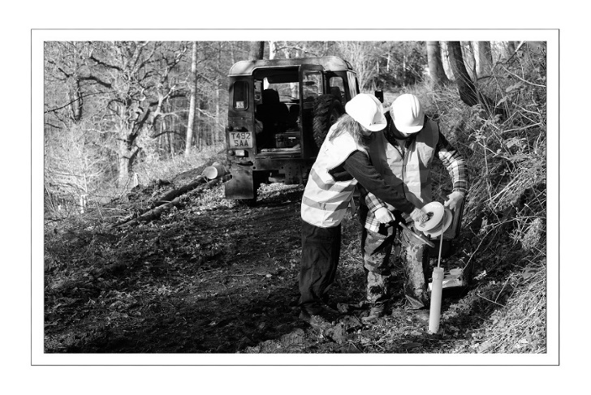
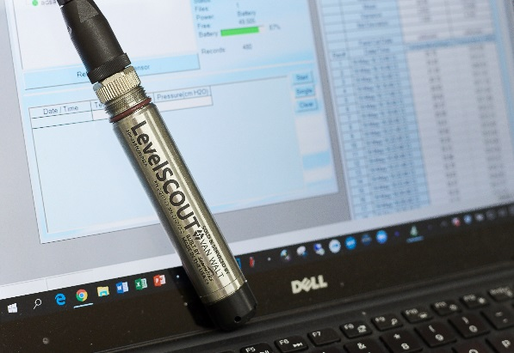
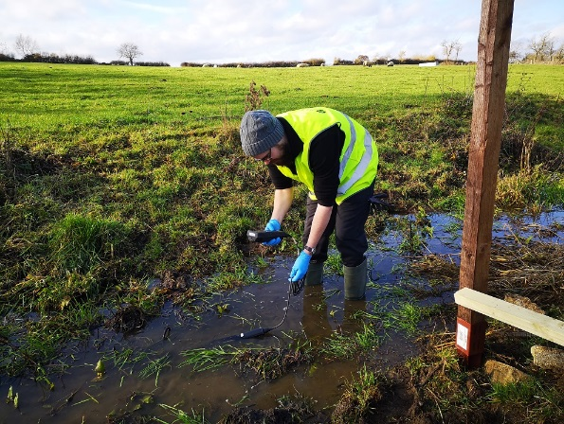
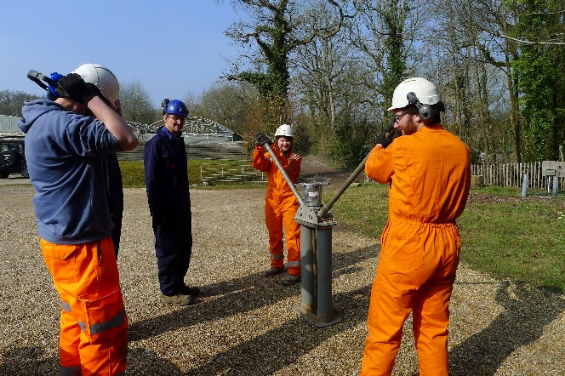
About Van Walt
Van Walt is a long established family business that supplies environmental research and monitoring equipment to rent or purchase
Three diverse locations – UK, Spain, New Zealand
We specialise in:
Groundwater Monitoring Equipment
Water Level
Water Quality
Soil & Sediment Sampling
Soil Moisture
Window Sampling Systems
Telemetry

Slide 3
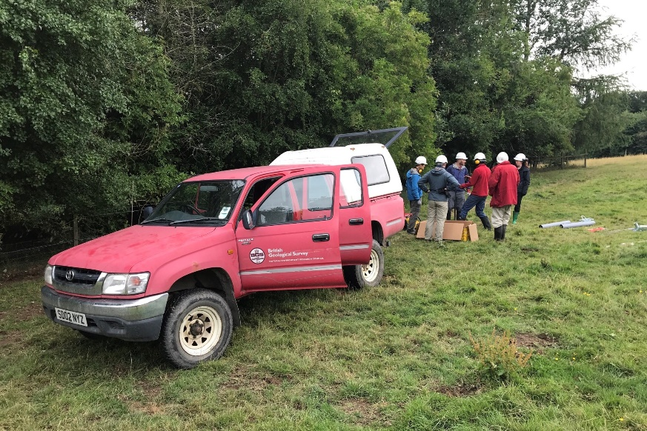
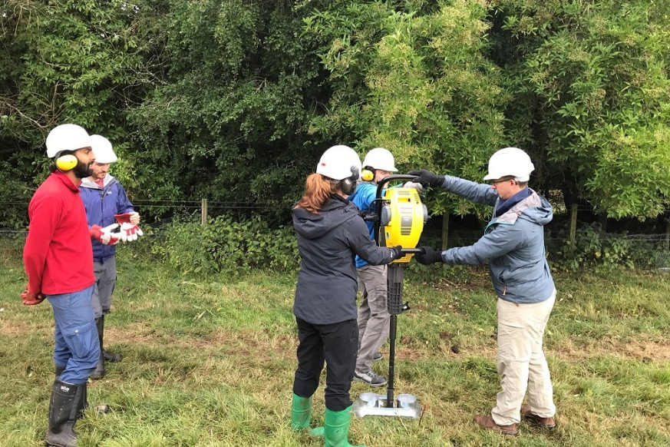
Customers
Environment Agency
County Councils
Universities
Environmental Consultancies
Archaeologists
Infrastructure Engineers
Government Departments
Research Institutes
Charities
Across 3 x markets

Slide 4

Soil Moisture

Slide 5
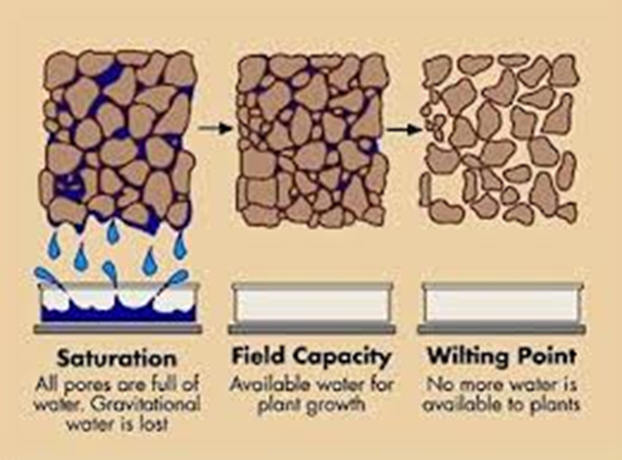
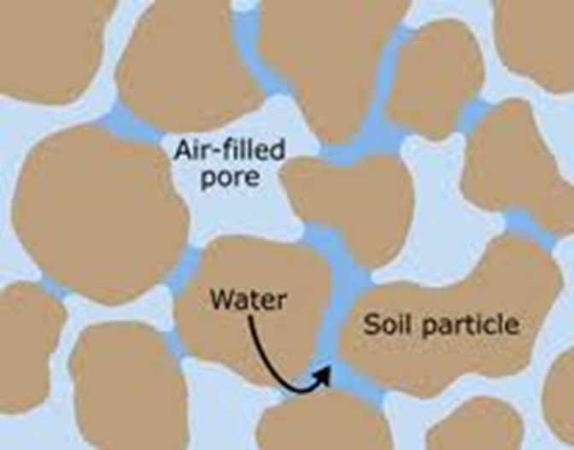
Soil Moisture Overview
Soil Moisture probes can be used to estimate the amount of stored water in a profile or how much irrigation is required to reach a desired amount of saturation.
How it works:
The buried probe sends electrical signals into the soil, measures the responses, and relays this information to a data logger
Notes:
Soils are typically about 45% mineral, 5% organic matter, and 50% voids (or pores) of which half is occupied by water and half by air or gas. During rainfall water moves in unsaturated soil through large pores and is pulled downwards.
Soil Moisture probes: These sensors can be portable and used for instant measurements or installed for long term monitoring.

Slide 6

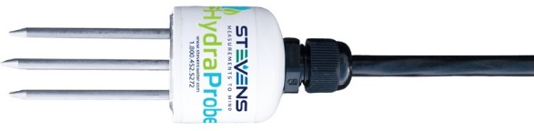
HydraProbe
Measures soil moisture, salinity and temperature
Can remain in-situ indefinitely, or relocated and redeployed without worry
Ideal for remote locations, harsh environments and applications where data is critical
Available in both SDI-12 or RS485
5-year warranty
Rugged soil moisture sensor with patented technology - Dielectric Impedance
Notes:
Developed by the physics department at Dartmouth College & is the only commercially available sensor that uses this technology

Slide 7
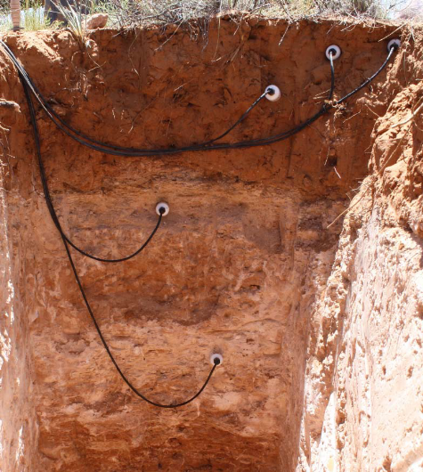
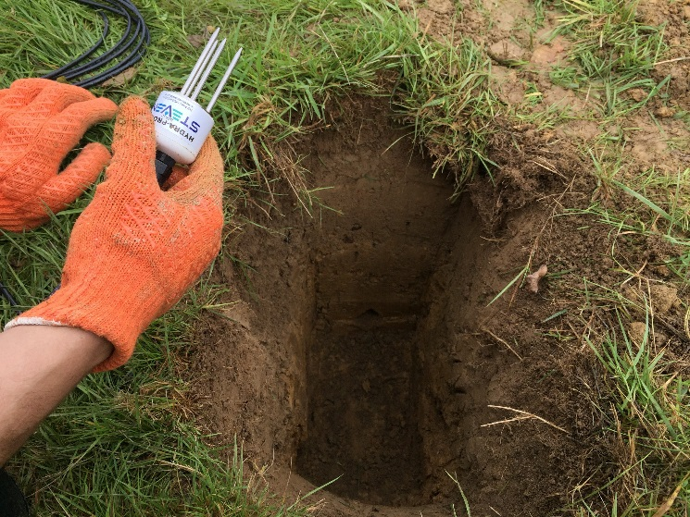
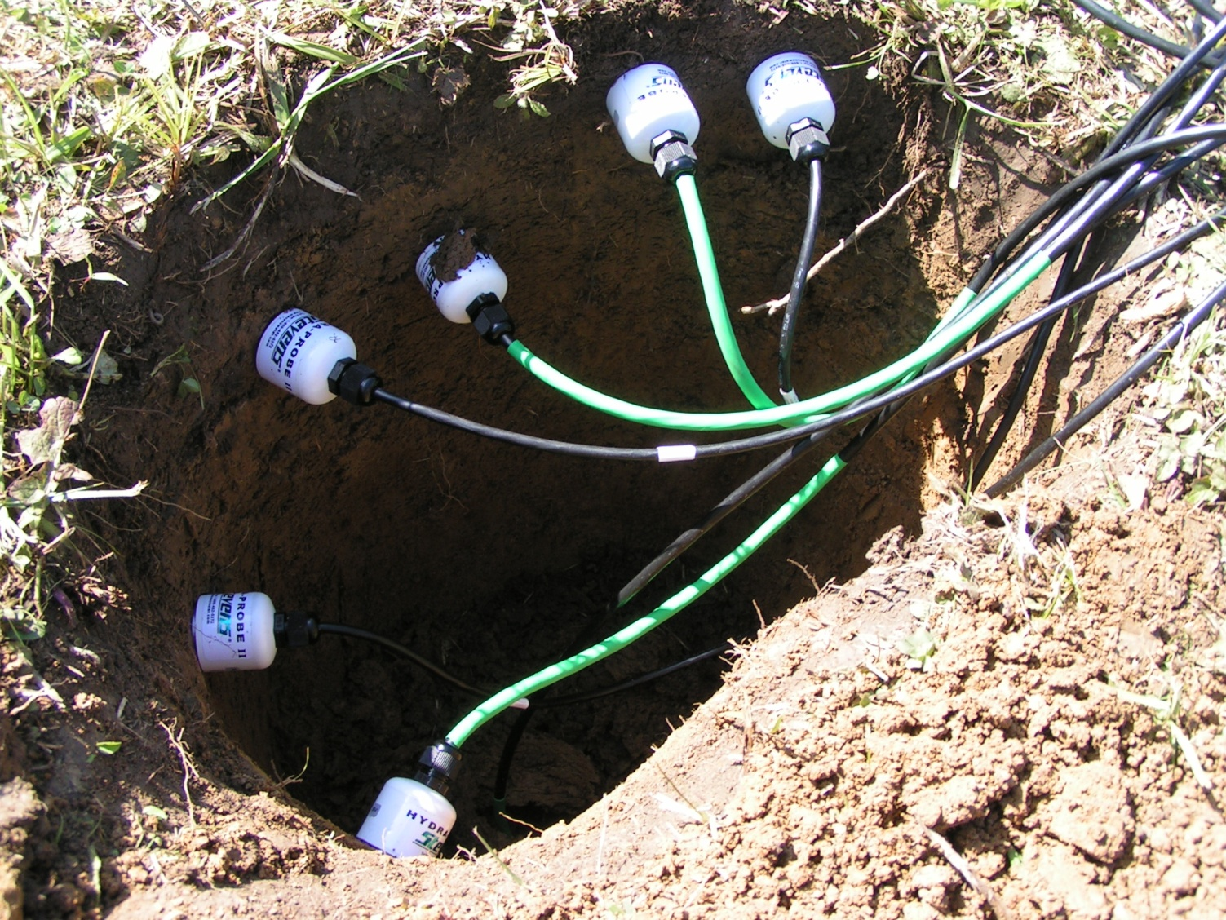
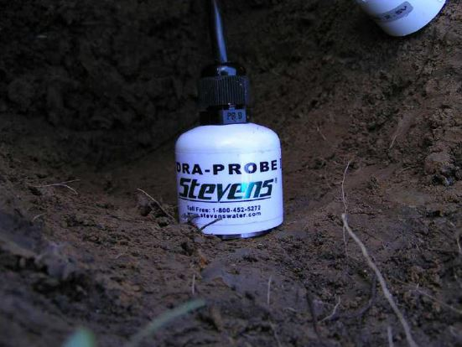
Installation
The soil should be undisturbed
Base plate of the probe needs to be flush with the soil
It’s important to note that the soil that resides between the tine assembly is where the measurements are taken. If there is a void space in the soil between the tines, this will affect the readings
Installed horizontally into the wall of the survey pit
Avoid rocks and pebbles
Notes:
Avoid rocks and pebbles this can damage the tines and affect the readings

Slide 8
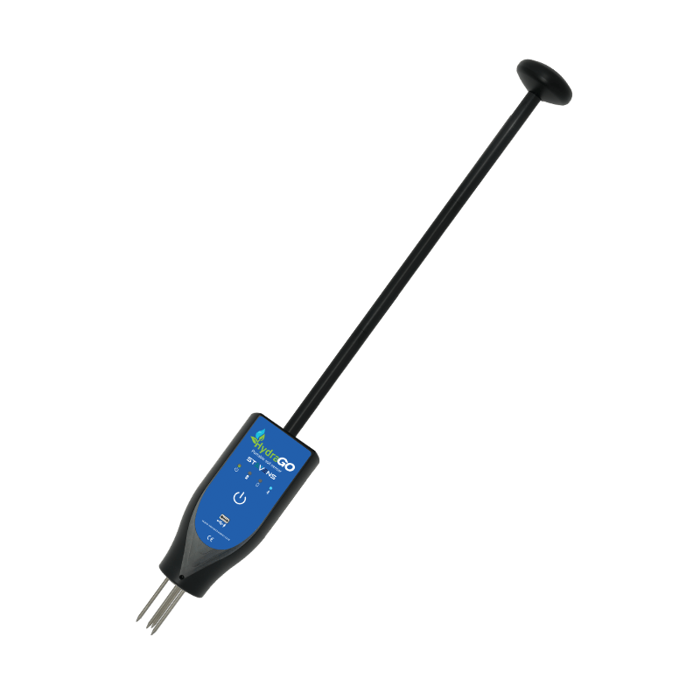
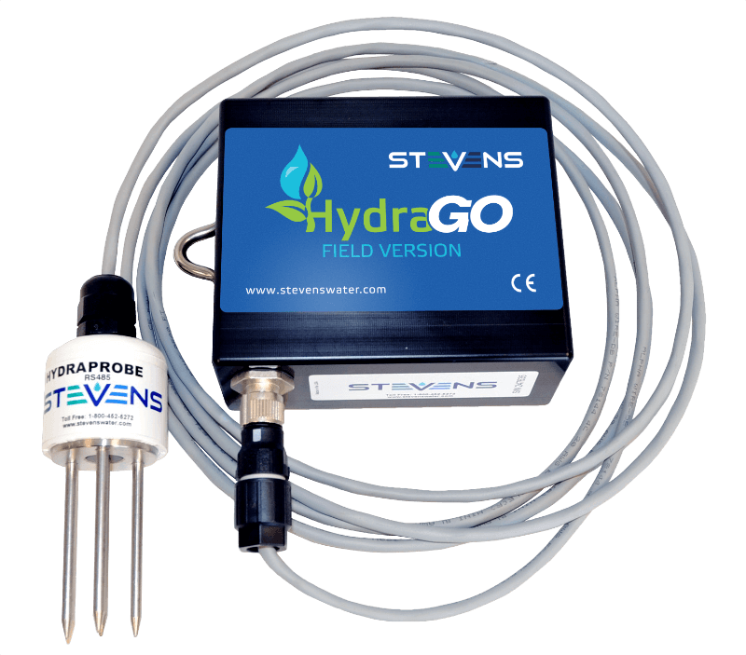
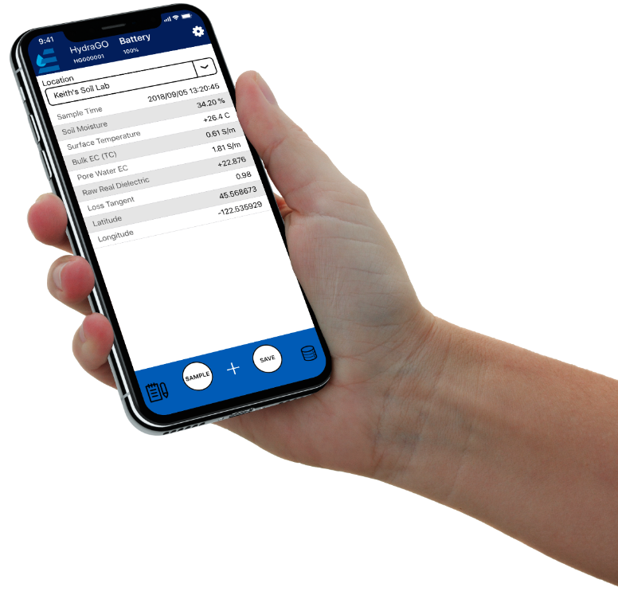
Portable solutions
HydraGO
HydraGO Field Version
Notes:
Take quick soil parameter measurements anywhere for those applications not requiring a permanent soil monitoring system. Use the free app to collect your data. Save it and email as a .CSV file for analysis in Excel later on. Simple!

Slide 9
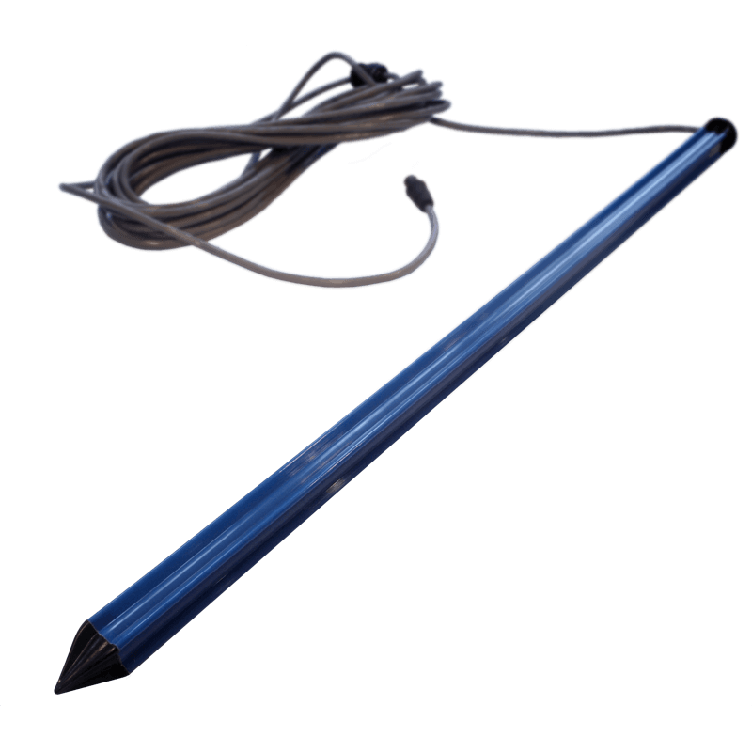
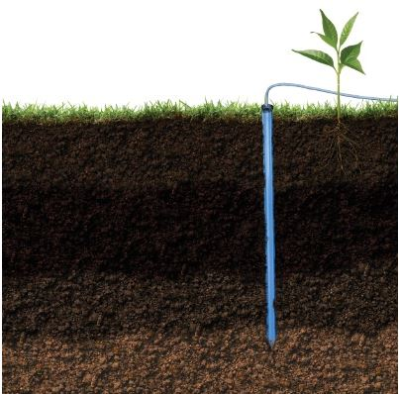
GroPoint Profile
Soil moisture and temperature
Measures across the entire length of the probe, averaging the soil moisture and temperature in each segment
Available in 2 to 8 segments – 30cm to 120cm
Installs quickly and easily without excavating
Installation tool available to reduce soil disruption and increasing measurement accuracy.
Notes:
Create a pilot hole the exact size required for the probe using a slide hammer tool attached to a steel pilot rod, this provides minimum soil disruption, further increasing measurement accuracy.

Slide 10
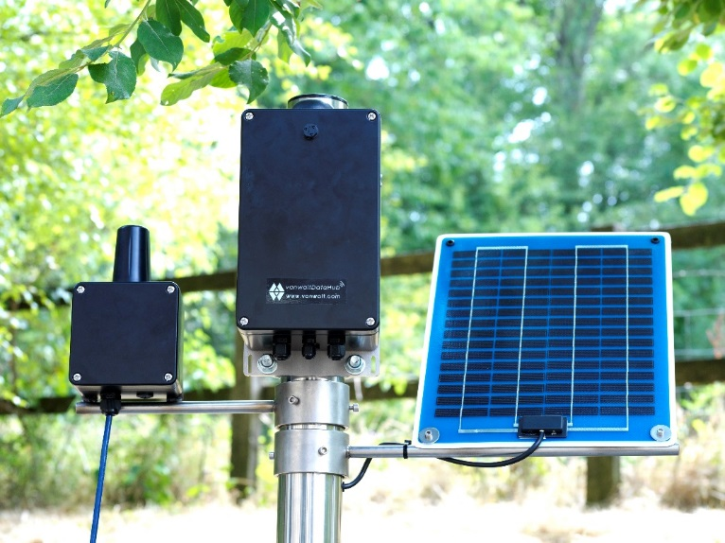
Readout Options
Telemetry
Manual readout devices
Why would you want data to be automatically collected?
The site is remote and expensive to access. Where it is cheaper to use technology to collect and transmit data rather than sending staff to site
Inaccessible sites so to gather data is very time consuming and might require specific permissions
Data is critical and needs to be frequently reviewed
Data needs to be shared by more than one person
Alarms need to be triggered in the case of a specific event.
Notes:
Point 2: Examples would be airports, motorways, restricted areas such as nuclear power stations.
Point 3: An example would be contaminated sites where the flow of a contaminant needs to be monitored.
Point 4: An example would be where a regulator needs to view the data to assess compliance.
Point 5: For example flood warning.

Slide 11
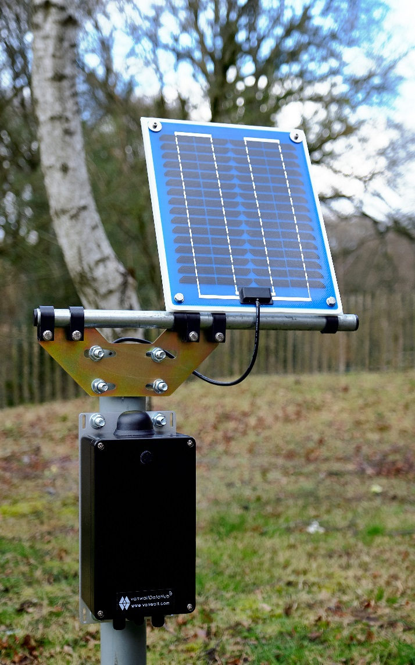
Telemetry
vanwaltDataHub
Eliminates the need to visit the site to collect the data, saving you time and money
Multiple, simultaneous inputs and outputs
Connects to a wider range of environmental sensors - Modbus, SDI-12, Analog and digital I/O are provided to connect sensors singly or in daisy chain
Data can be used to trigger alarms; switches; other sensors and gauges
Works in remote locations as a data-logger or telemetry system for distributing or sharing data through on-board memory, radio frequency, GPRS or Satellite portals.

Slide 12
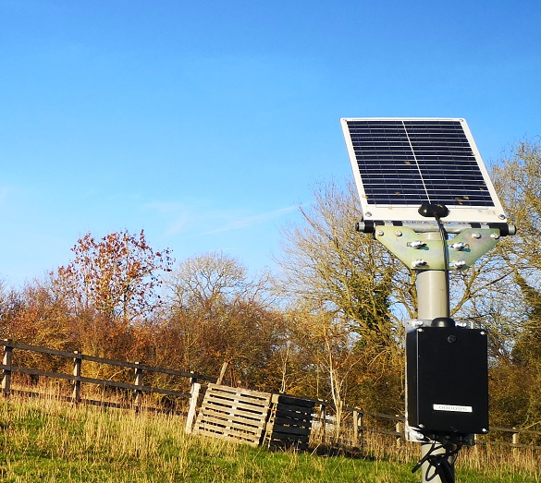
vanwaltDataHub
Data is stored on non-volatile memory and backed up for redundancy on an internal flash and SD card and for convenience by an external, vandal-resistant industrial grade SD card
Flexible design to suit your project requirements
Works with most legacy systems / sensors
Designed and developed by Van Walt Ltd
Fully backed by the Van Walt technical team
Manufactured in the UK
We can carry out all the installation - no matter the location
2 year manufacturers warranty
Conveniently packaged in an IP rated, heavy duty aluminium enclosure. OEM version available.

Slide 13
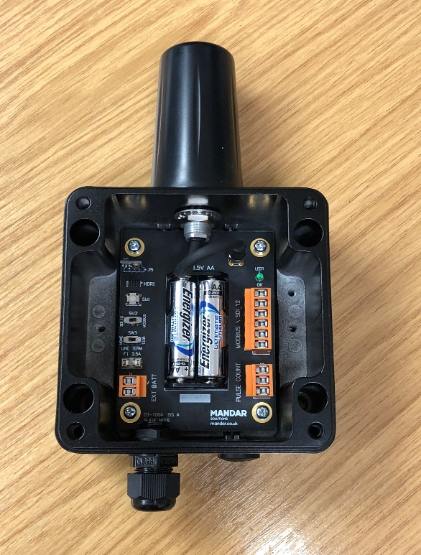
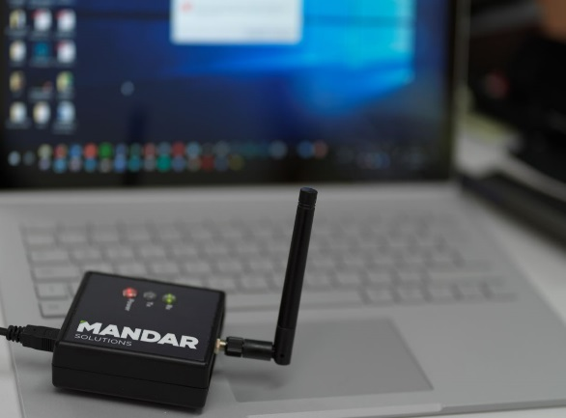
Telemetry
vanwaltDataSlave
Modbus or SDI-12 interface compatible
3-year battery life
Pulse count input
Switchable +12V sensor output supply
Internal Battery voltage measurement & sensor external power voltage measurement
In-built connectivity to Fleck Radio Gateway
Secure wireless communication
Low power sleep mode with automatic wake up at required interval & upload.
Notes:
The vanwaltDataSlave turns any sensor into a wireless unit. It sits at a location and transfers sensor measurements using radio frequency up to 10 km line of sight. If the connected sensor has memory then the vanwaltDataSlave transmits the data from the sensor’s internal memory. If the sensor does not have memory then the DataSlave collects the data from the sensor and stores it inside its own onboard memory.

Slide 14
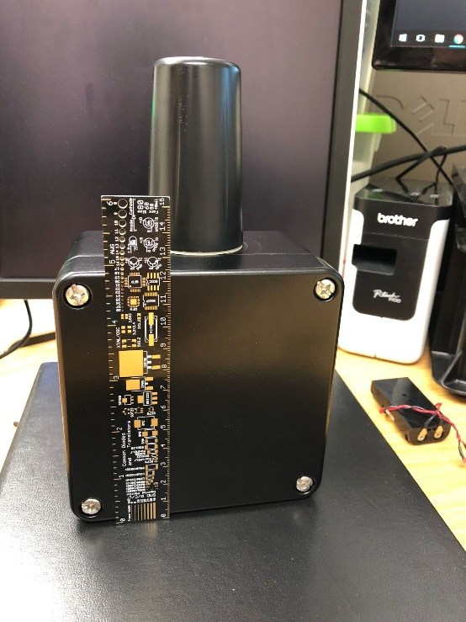

vanwaltDataSlave
The data can be retrieved directly to a PC / Laptop by radio communication
Network multiple sensors for a cost-effective telemetered system
Creates wireless networks with multiple brands of sensors
License free, subscription free
Designed and developed by Van Walt Ltd
Fully backed by the Van Walt technical team
Manufactured in the UK
Powered from 2 x AA batteries but accepts larger battery input (12 v) for higher power applications
Can also be coupled with the vanwaltDataHub to eliminate site visits.

Slide 15
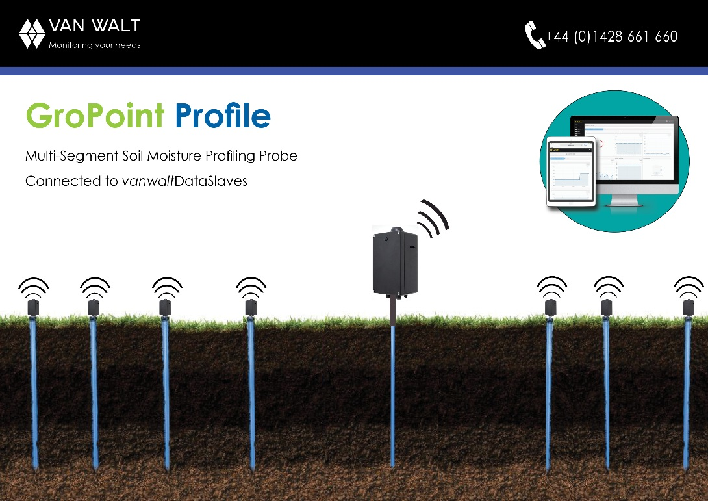
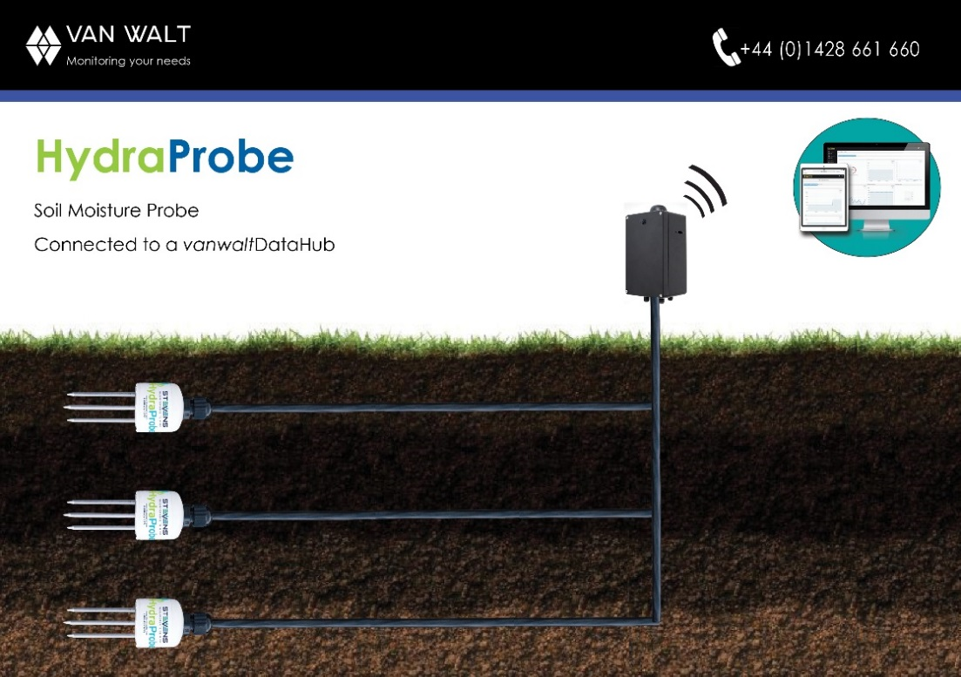
Examples
Maximising the benefits that automated equipment can provide in order to minimise the cost of site data acquisition

Slide 16
Groundwater

Slide 17
Groundwater Monitoring - Overview
Groundwater makes up nearly 30% of all the world’s freshwater
Almost all the water we use for agriculture, industry and drinking water is either groundwater or has been groundwater at some point in the water cycle
It is often present in areas where there is limited surface water sources
Groundwater supports rivers, lakes and wetlands and is essential to the health of wildlife and plants that live in the water
Groundwater normally requires less treatment than river water to make it safe to drink. The soil and rocks through which the groundwater flows helps to remove pollutants
The quality and quantity is consistent
Groundwater doesn’t require expensive reservoirs to store water before it is used.
That’s why it is important to monitor, measure, sample and test
Van Walt has everything you need to do this!
Notes:
Water is continually moving through the environment. Water evaporates from the oceans, condenses into clouds and then falls on land as rain, only to flow into rivers and back into the sea. Groundwater is often the ‘forgotten’ element of the water cycle. It is where most of the rainfall ends up via infiltration downwards into the rocks to become groundwater. The level at which the rock becomes saturated is called the water table.

Slide 18
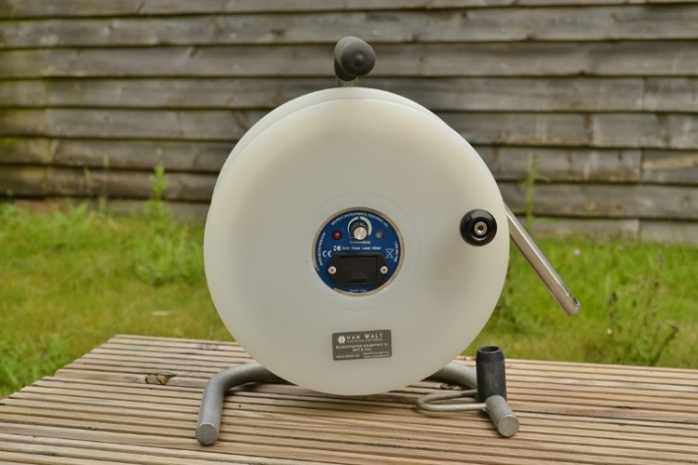
Water Level Monitoring
Classical way: going onsite with a water level meter & making a manual measurement
Advantages:
Cheap and simple instrument, used at multiple points
Disadvantages:
Measurements from time to time, maybe changes not noticed
Possible human error
Man hours spent on something that could be done automatically
A better way with Water Level Loggers
ABSOLUTE OR VENTED?
Absolute: Measures total pressure (weight) above the sensor. Atmospheric pressure must be removed from this value to reveal actual water pressure (water column).
Vented: Measures only water pressure above sensor. Atmospheric vent accounts for atmospheric pressure.

Slide 19

Absolute Loggers
LevelSCOUT Water Level Logger
A small pressure sensor logger all contained in a small format with an internal battery suspended in a well.
Measures water level and temperature
Good weight making it easy to deploy
Replaceable batteries
Rugged and robust
Easy to use
Requires barometric compensation
Manual readout
Free and easy to use software.

Slide 20
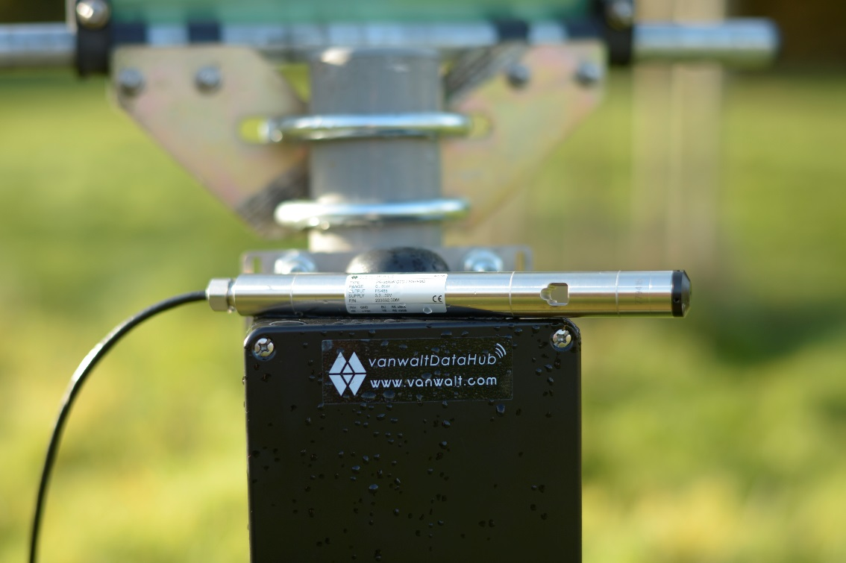
Vented Loggers
Keller Sensors
Range of high accuracy sensors that connect to Van Walt’s telemetry systems
Options:
Surface Level Sensor
CTD Sensor
Water Level and Temperature Sensor
Narrow diameter Level & Temp Sensor
Benefits:
High accuracy
Robust stainless-steel housing
Ultra-high long-term stability
Supplied with vented Kevlar Cable so no barometric compensation required
Available from stock with Modbus connection.

Slide 21
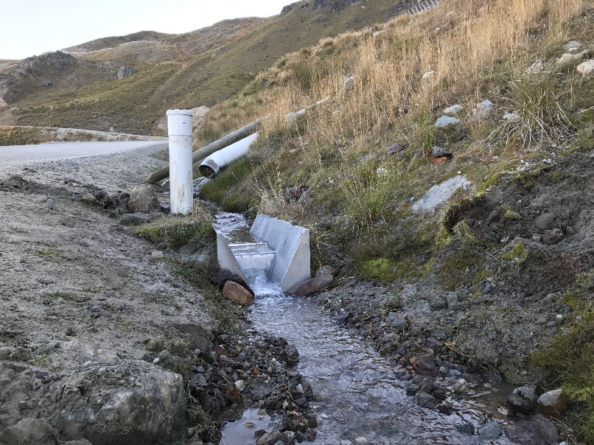
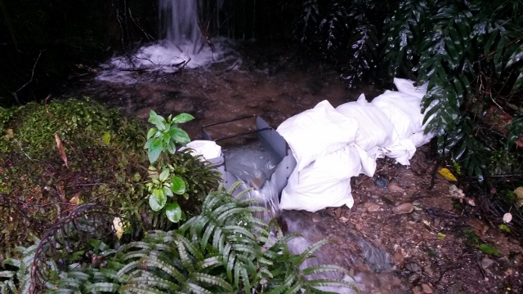
Water flow monitoring
A calibrated flume is required to calculate water flow to the nearest Litre per second
Flumes are specially shaped, engineered structures that are used to measure the flow of water in open channels
Flumes have no moving parts
Flumes can use a change in elevation, a contraction of the sidewalls or a combination of the two to accelerate flow
The water level is measured in a stilling well that is connected to the main body of water by a small capillary
The relationship between the water level at the point of measurement and the flow rate can be obtained by a derived formula.
Notes:
Point 3: Flumes rely on restricting the flow of water in such a way so as to develop a relationship between the water level in the flume at the point of measurement and the flow rate.
Point 4: This acceleration creates upstream conditions where the flow rate can be determined by measuring the water level at a single point.
Point 5: . This ensures that the measurement is unaffected by surface distortion (waves, current)

Slide 22
Many Thanks

