Slide 1

Groundwater sampling and
purge techniques
Acquiring a representative sample

Slide 2

Your Resources:
ISO Standards (5667)
GNS National Protocol

Slide 3
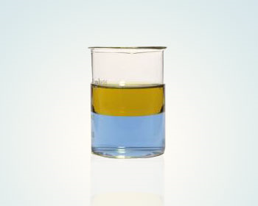
What are we trying to achieve?
A REPRESENTATIVE SAMPLE!
Why is this so important?

Slide 4
Acquiring a representative groundwater sample starts with?

Slide 5
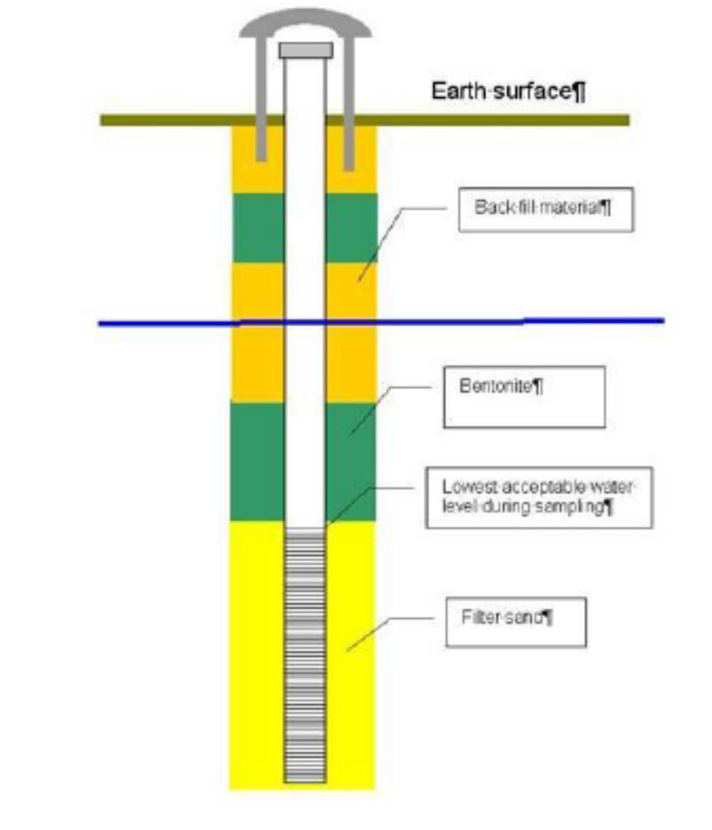
Installation of Monitoring Wells
Aim of a well is to produce water representative of the groundwater surrounding the screened part of the well

Slide 6
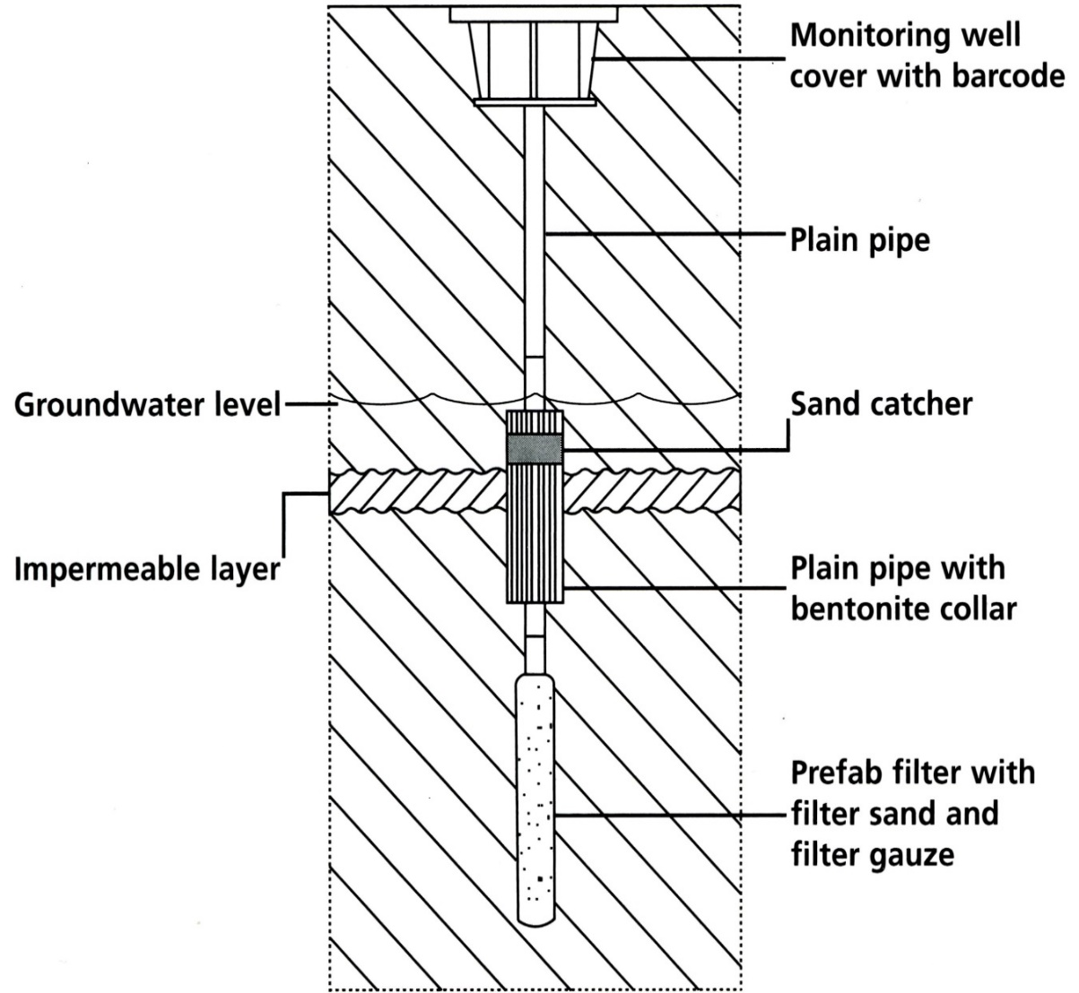

Quality well installation
A window not a chasm!
Discrete installation. Reduce impact above and below ground.
Quality trustworthy materials (certified?)
Impermeable layers sealed (which aquifer are you measuring?)
Screened section below minimum groundwater level
Screen slot size?
Filter gauze and sand pack
Back filled around remainder of blind pipe
Natural stability?

Slide 7
Purging Monitoring Wells Prior to Sampling
Why purge?
To remove silty material and deposits from the bottom of the well
To remove stagnant oxidised water
To attract groundwater from the aquifer!!

Slide 8
Three sampling methods currently in use
High flow purge
Low flow
No flow

Slide 9
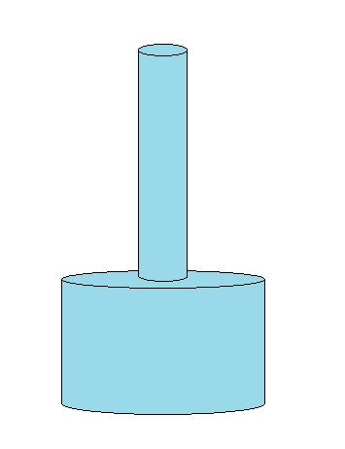
Classical High Flow Purge Method
44mm
Purge 3 x wetted well volume
5m
Large volumes of waste water
Greater potential for draw down
Requires expensive high flow pumps
Larger pumps require larger well pipes
Not suitable for VOC sampling (heat and cavitation)
High turbidity
Wetted well volume: 12.3L
Total purge: 37L
1m
90mm

Slide 10
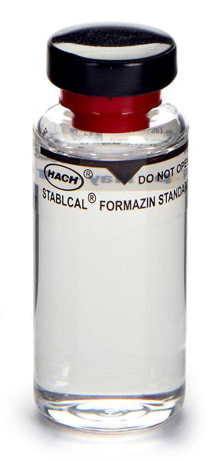
Why turbidity is so important?
If a water sample is filtered containing PAH, PCB, dioxins, microorganisms (E. coli, Giardia) and a number of pesticides none of these components will be found
Are we measuring soil or water?
If the sample is not filtered, above pollutions adsorb to sediments and are finally analysed as being water pollution!
Adsorbed contaminants in suspended sediment can amplify water analysis up to 1000 times! In soil: mg/L. In water: µg/L

Slide 11
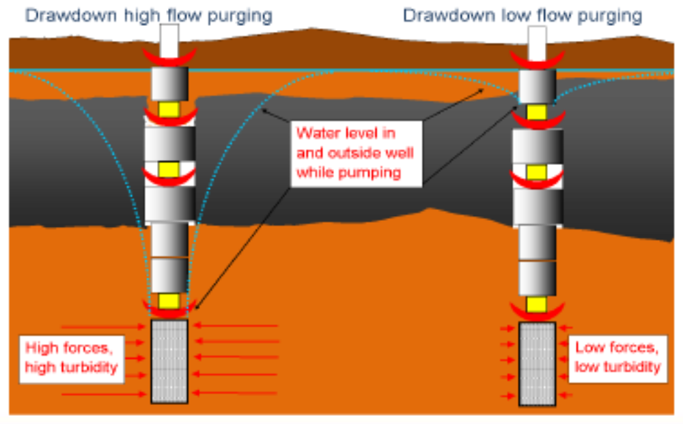
Reducing turbidity
Quality well installation
Fine slotted pipe
Reduce forces within well installation
Minimise disturbance

Slide 12
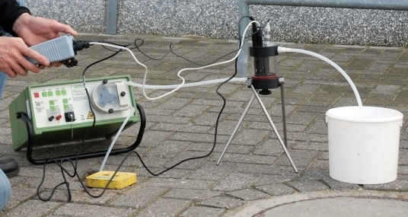
Low-flow or Micro-purging
Small volumes of waste water: 10m 4mm ID tubing: 50ml plus volume of pump = 500ml?
Can be deployed in small diameter wells
Minimal draw down
Pump/tubing is positioned in the screen section of the well
Adjusted to an extremely slow speed (±500ml/minute).
There should be no need to renew (purge) the water in the blind section
Look for stability (water quality meter) then Purge a further 3 x pump volume.

Slide 13
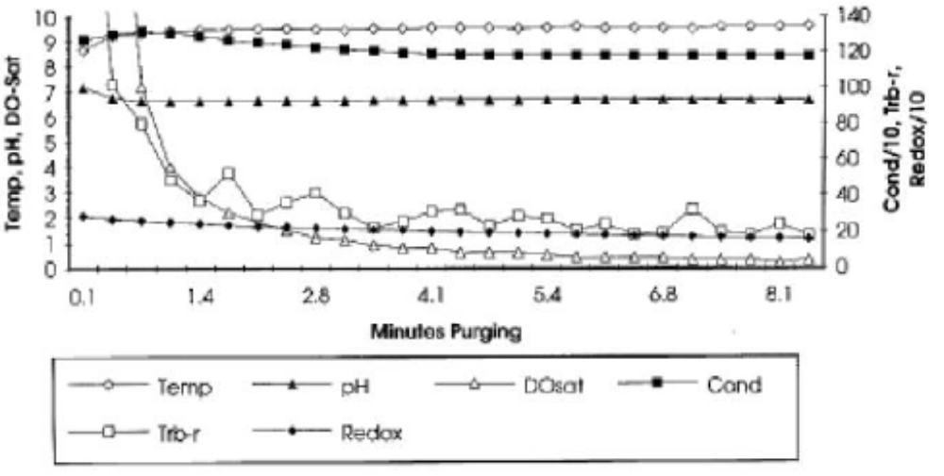
Stabilisation during micro-purging
ISO requires EC as indictor
Indicators in this scenario are:
DO%
Turbidity

Slide 14
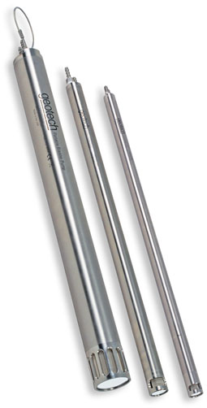
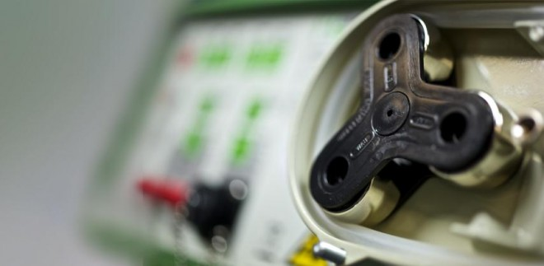
VOC sampling with a peristaltic pump?
4% to 30% loss of VOCs
US EPA suggests effective use down to 4.5m bgl
More repeatable than the alternative?

Slide 15
No-Purge Sampling
No water purged prior to sampling
Initially developed (+/- 2002 DOD, USA) to improve the cost effectiveness of groundwater monitoring programs for VOCs
Many different studies on cost saving. Vary from 70% - 40%.
Natural stability!!!

Slide 16
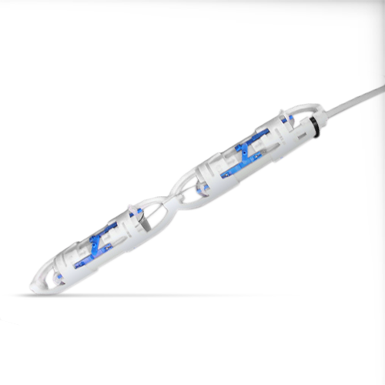
Grab sampler; SNAP sampler
An equilibrated instantaneous “snap-shot” in time of groundwater conditions
Deployed in a well and left until groundwater conditions have re-equilibrated. At least 3 days.
At that time the groundwater is captured by the device, and the resulting sample is submitted to the laboratory for analysis
Requires larger diameter well
Smaller sample volumes
Ideal for VOC sampling (Very good for CH4)
Repeatable results

Slide 17
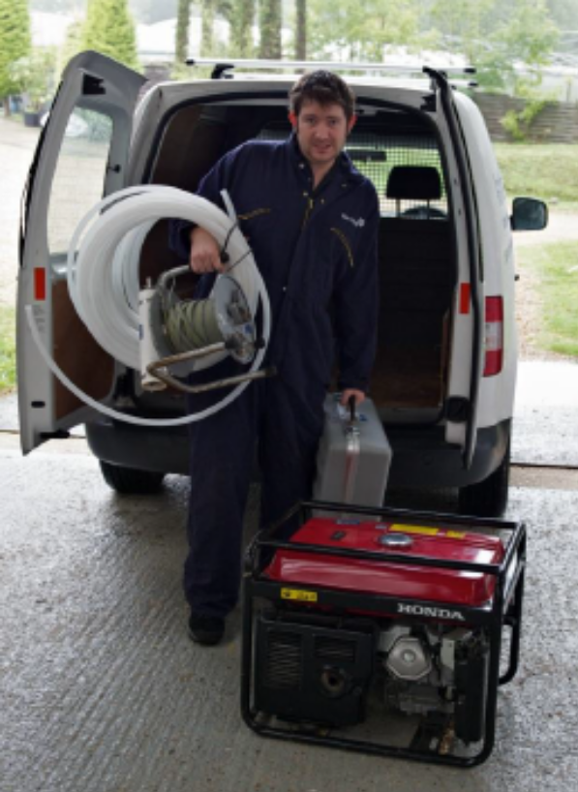

Where are we heading?
More accurate results
Repeatable samples
Less time onsite
Less cost
Less disruption

