Slide 1

Current directives make groundwater sampling expensive and environmentally irresponsible hence a move from high flow to low flow to no purge sampling.

Slide 2
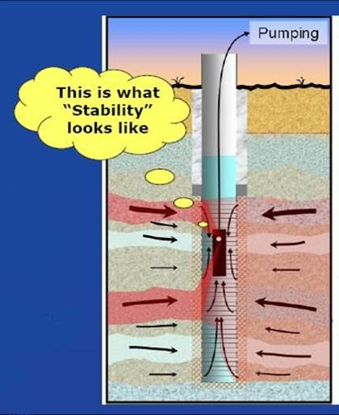
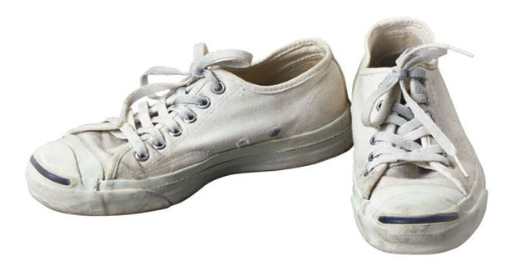
Groundwater Sampling
Sampling a well with a tennis shoe?
2

Slide 3
Standards, Directives, Guidelines..................

Slide 4
Standards, Directives, Guidelines
Hierarchy:- “more or less a general consensus” EN/AS/NZS=➔ISO=➔BS=➔Local Guidelines
BS 10175:2011 – Investigation of potentially contaminated sites - Code of practice
Things could have been so simple.......

Slide 5
Standards, Directives, Guidelines
BS 10175:2011 8.3.3.1 “Groundwater sampling should be carried out in accordance with BS ISO 5667-11
Introduction: “The guidance in this part of ISO 5667 can be used in parallel with other guidance....”
Materials for sampling equipment ISO 5667-1, QA of environmental sampling...ISO 5667-14, Preservation... Parts 1, 3, ......................

Slide 6
Monitoring wells

Slide 7
Installation of Monitoring Wells
Aim of a well is to produce water representative of the
groundwater surrounding the screened part of the well

Slide 8
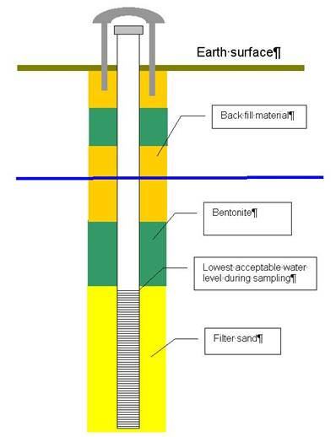
Installation of Monitoring Wells
Principle of a correctly installed monitoring well
Care in ensuring that impermeable layers are not perforated

Slide 9
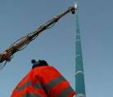
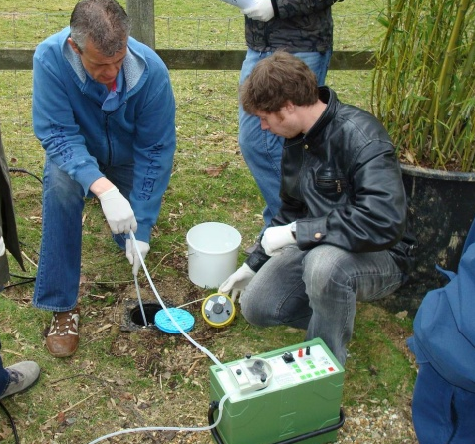
Installation of Monitoring Wells
Why install a well that can serve a small town if you only need small (but representative) water samples?

Slide 10
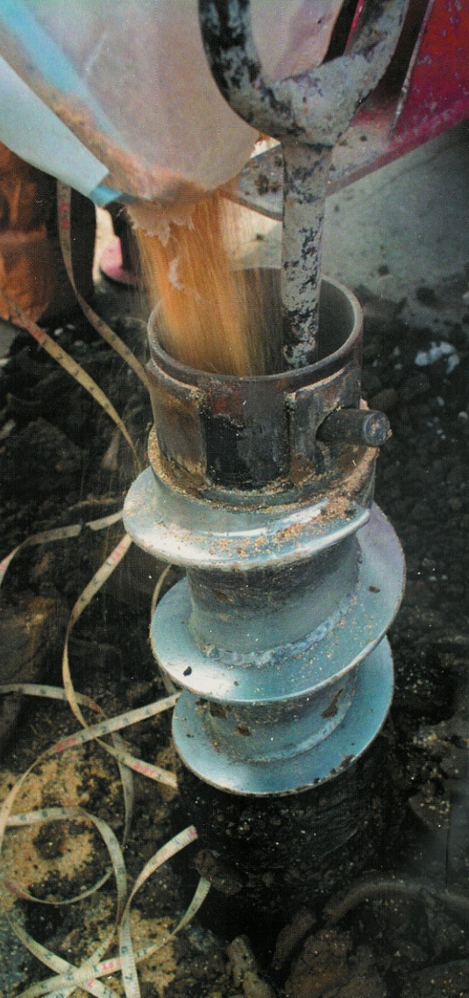
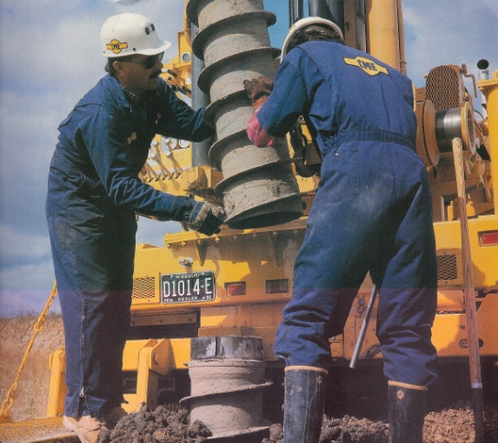
Installation of Monitoring Wells
Hollow stem augering
  Very common technique for environmental drilling
  Drill leaves large volume to fill with filter sand and bentonite!

Slide 11

Installation of Monitoring Wells
QA/QC
All materials used in the construction of wells should be certified clean e.g. KIWA
This includes:
Well pipe
Filter sand
Bentonite
This applies to all materials used in groundwater research e.g. tubing, filters……..

Slide 12


Installation of Monitoring Wells
Characteristics of well and plastic sampling material
All plastics have a “memory” effect
    Small organic molecules (like benzene) will enter in the micro-pores of the plastic and will only come out with time. Rinsing and rubbing will not help.
    A well placed in a polluted soil will, during remediation, never become so clean as the soil itself !
    Only solution: Place a new sampling well.
Blind well section
Micro-pores
Benzene

Slide 13
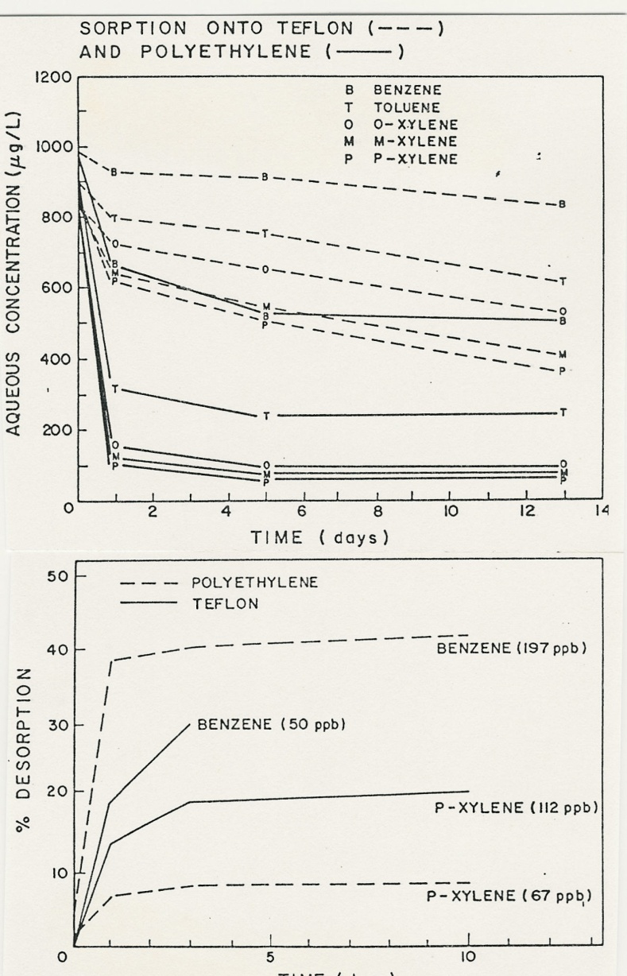
Installation of Monitoring Wells
Sorption and de-sorption of volatiles on / to Teflon and PE tubing
Top: Sorption of BTEX to PE and Teflon tubing.
Bottom: De-sorption of BTEX from contaminated Teflon and PE tubing into ultra pure water

Slide 14
Purging

Slide 15
Purging Monitoring Wells
Prior to Sampling
Why purge
  To remove silty material and deposits from the bottom of the well.
  To remove stagnant oxidised water
  To attract groundwater from the aquifer!!

Slide 16
Purging Monitoring Wells
Prior to Sampling
“Classical Procedure” 3 X wetted well volume
Total volume = (wet volume + volume filter pack) x 3
Ø 44 mm
Ø 44 mm
5,0 m
Total: 60 l
Total: 31 l
23 litre
94*0,4 litre
19*0,4 litre
1,0 m
90 mm
200 mm

Slide 17
Groundwater Sampling

Slide 18
Groundwater Sampling
Mixing of what looks like a homogeneous aquifer
  K_{horz.} > K_{vert.}
  _{Stagnant water}
  _{Temperature gradients}
  _{Borescopes,} _{flow direction models}
18

Slide 19
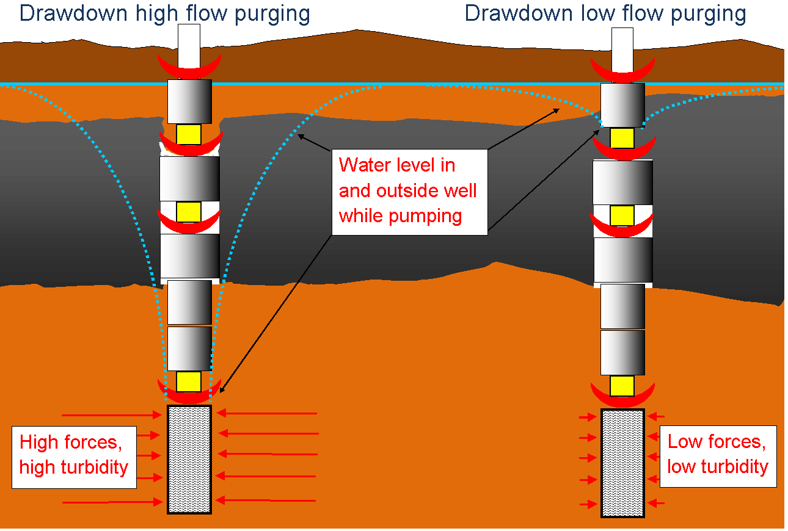
Groundwater Sampling
Low-flow or Micro-purging
  Pump is hung in the filter part of the well
  Adjusted to an extremely slow speed there should be no need to renew (purge) the water in the blind section
19

Slide 20
Groundwater Sampling
Reducing turbidity
  By reducing the forces that push soil particles into the well, turbidity of water samples can be brought down substantially and sample quality will increase significantly.
20

Slide 21
Groundwater Sampling
Why turbidity is so important:
  Problem:
    If a water sample is filtered containing PAH, PCB, dioxins and a number of pesticides none of these components will be found
    If the sample is not filtered, above pollutions adsorb to sediments and are finally analysed as being water pollution!
    Prof. John McCarthy measure turbidity less than 10NTU
    European guidelines. If turbidity is likely to affect results add turbidity measurements to your report!
21

Slide 22
Groundwater Sampling
The water quality indicator parameters:
  pH, specific EC, DO, Redox and turbidity.
    These parameters should be recorded after a minimum of one tubing volume (include pump and flow-through-cell volumes) has been purged from the well
    Once three successive readings of the water-quality-indicator parameters have stabilised, the sampling may begin.
    Standard still only mentions EC as obligatory but DO better but not accepted (yet).
22

Slide 23
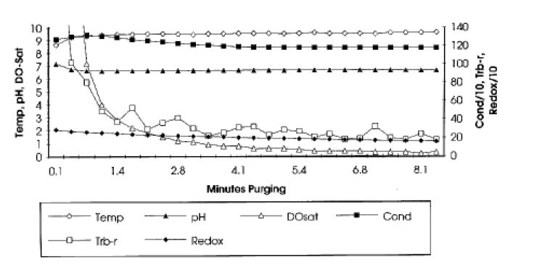
Groundwater Sampling
Stabilisation during micro-purging

Slide 24
Groundwater Sampling
Organic non-polar compounds - Reminder
  Especially when sampling for contaminants that may be biased by the presence of turbidity, the turbidity reading is desired to stabilise at a value below 10 Nephelometric Turbidity Units (NTU’s).
24

Slide 25
Groundwater Sampling
VOC, SVOC’s
Peristaltic pumps will underestimate VOC’s but compensated by reduction in variability.
Better to underestimate.
ISO 5667-11 (page 12) table with recommended sampling devices
Bladder pumps best but…..

Slide 26
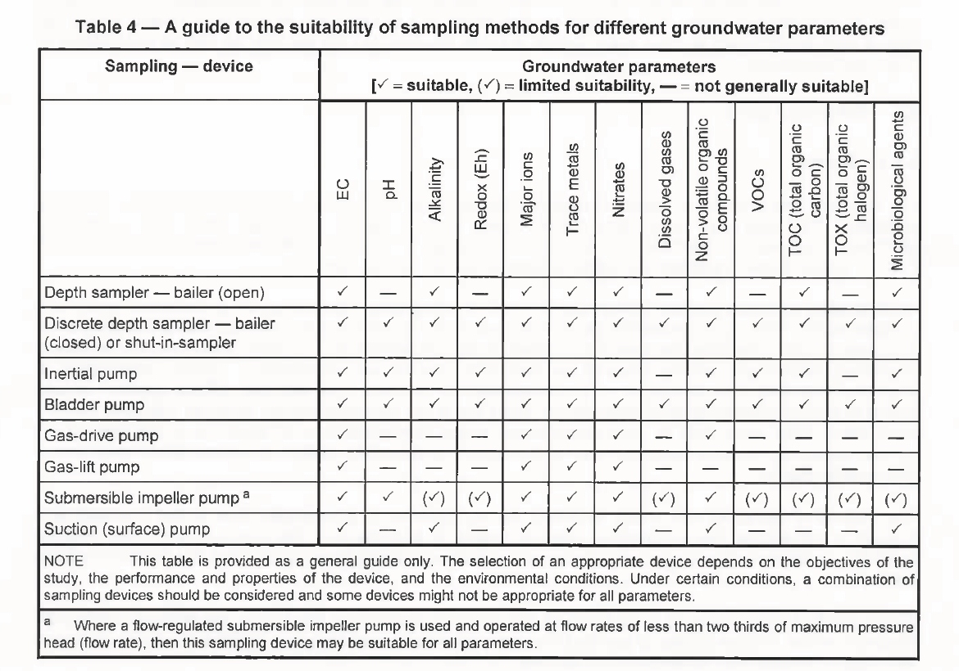

Slide 27
Passive samplers

Slide 28
Groundwater Sampling
No-Purge Sampling
No water purged prior to sampling
Initially developed (+/- 2002 DOD, USA) to improve the cost effectiveness of groundwater monitoring programs for VOCs.
Many different studies on cost saving. Vary from 70%-40%

Slide 29
Groundwater Sampling
Passive sampling = no purge sampling (?)
New definition is in the making EPA (USA)
  Three different principles:
    Diffusion
    Grab
    Adsorption

Slide 30
Groundwater Sampling
Things in common to all no purge samplers
Must be left in place for a “period” so the samples are not affected by movement of the sampler through the water
This time-lag is variable depending on several factors such as the groundwater temperature, the physicochemical properties of the compound of interest, and the diffusive membrane used in the samplers
All very good for low recharge wells
All save substantial cost and produce no purge water
Results obtained using these devices will not always be comparable with results obtained using conventional sampling
Easy to use - no training or special tools required

Slide 31
Groundwater Sampling
No-Purge Sampling With Diffusion Samplers
Chemical constituents in the groundwater diffuse across the membrane over time
The chemical content of the water inside the sampler reaches equilibrium with the chemical content of groundwater in that interval of the well
There is a time-lag between the time groundwater enters a well and the diffusion of the chemicals in the groundwater into a diffusion sampler.

Slide 32
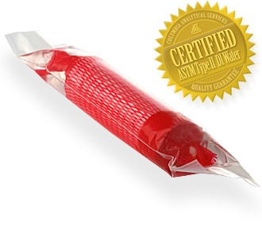
Groundwater Sampling
Diffusion sampler: RPP Samplers (Columbia Analytical)
Rigid Porous Polyethylene
Small Size (3.8 X 15.75mm)
Pore size 6-15 microns means potentially can sample all water soluble analytes, such as Perchlorate, 1,4-dioxane, Inorganic anions and cations, Metals, MEE parameters, MTBE, Hexavalent chromium, Explosives, Dissolved gases
BUT:
Shelf Life and air bubbles
Unreliable with some analytes

Slide 33
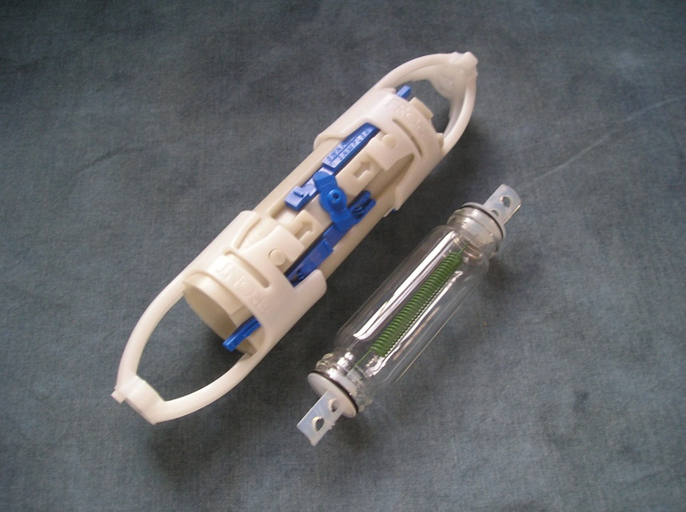
Groundwater Sampling
Grab sampler: SNAP Sampler
An equilibrated instantaneous “snap-shot” in time of groundwater conditions.
Deployed in a well and left until groundwater conditions have re-equilibrated.
At that time the groundwater is captured by the device, and the resulting sample is submitted to the laboratory for analysis.

Slide 34
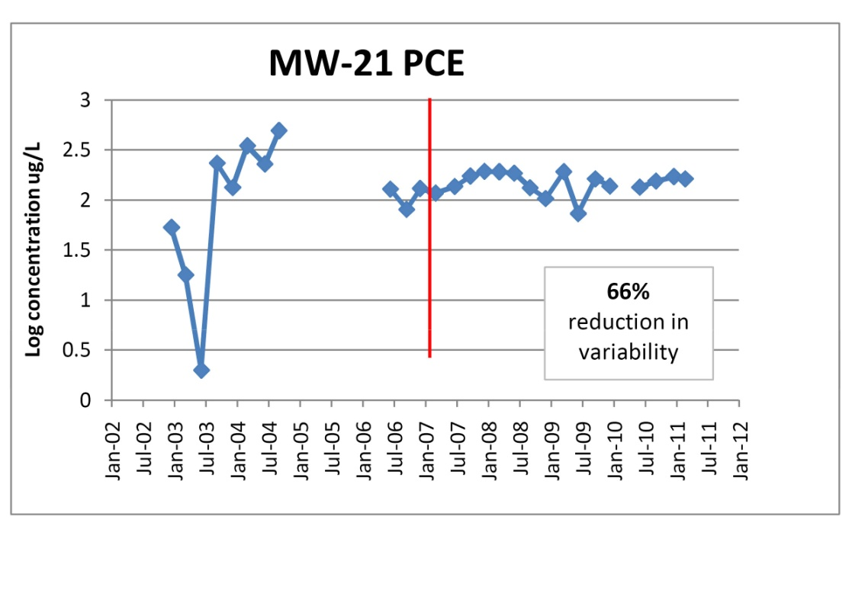
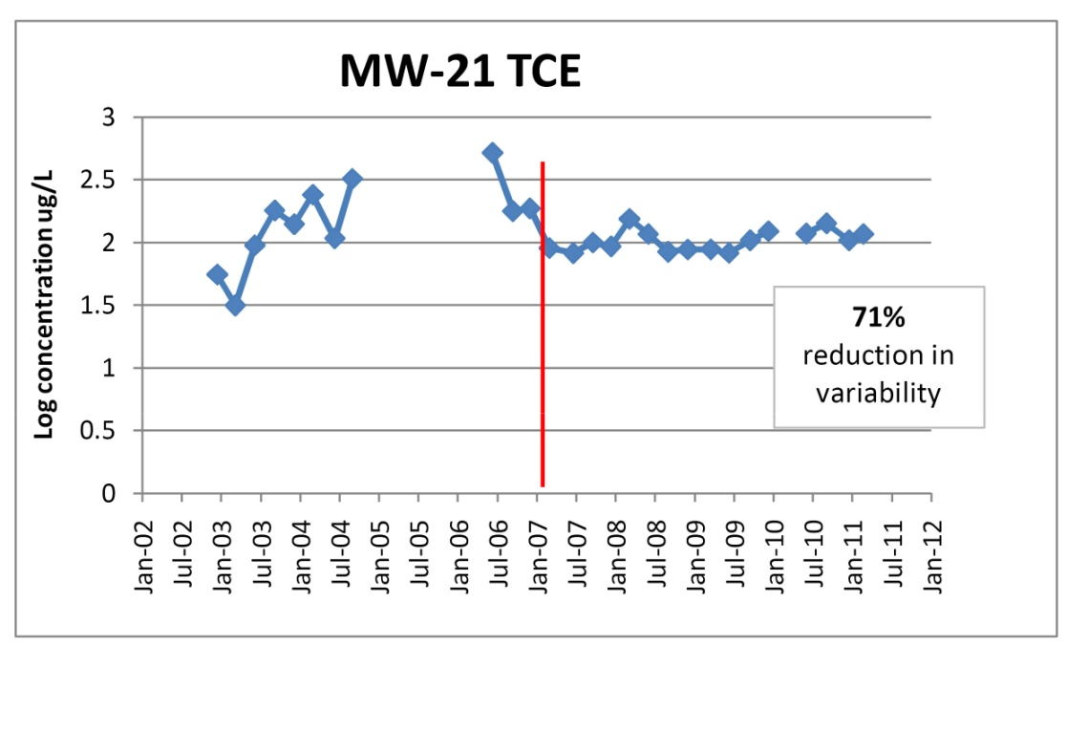
Groundwater Sampling
Snap Sampler Comparison Graphs

Slide 35
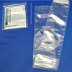
Groundwater Sampling
Grab sampler: Hydrasleeve
Sample for ALL compounds
Large sample volume
Repeatable sampling method but dependent on the person sampling
Easy to use - no training or special tools required
Easy Logistics
Inexpensive
Problem with turbidity
Problems with VOC recovery
*** No longer allowed to be called “passive” but OK as no-purge as to new USEPA guidelines
Only real merit is price. Factor 3 errors reported (Arcadis USA)

Slide 36
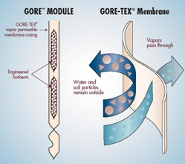
Groundwater Sampling
Absorption samplers: Gore Samplers
“Goretex” air permeable but not water
Can sample air, soil gas, and water
Easy to deploy
VOC’s trapped in carbon, SVOC’s in polymer. Double up of membranes
No post sampling freezing/cooling of samples. Once vial closed, compounds are trapped.
But: Field blanks!!!
Equilibrium time must be reported to the lab
Expensive (USD 250 per sample)
Can only be analysed by GORE lab.

Slide 37
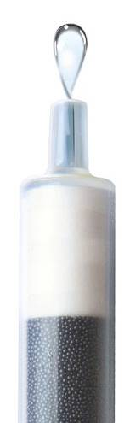
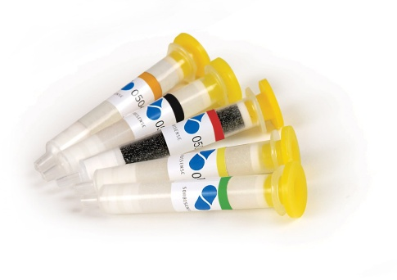
Groundwater Sampling
    SorbiSense
    Small porous cartridges filled with sorbents and also contain environmentally neutral tracer salt, that dissolves proportionally when water transits the cartridge.
    The ratio M / V gives the flow-proportional concentration of the solute during installation
    SorbiCell's are especially suitable for measuring nitrate and phosphorous, pesticides, volatile organic compounds, oil, tar and heavy metals.
    Limited shelf life (3 months).
Water flow

Slide 38
Groundwater Sampling
No purge samplers and Labs:
May need to deal with smaller volumes but limits of detection
May need new techniques to deal with e.g.
    Sorbicell
    Gore

Slide 39
Conclusion
Probably not BUT
Current standards and guidelines are still very much encouraging the use of high volume purging (“....when large volume purging not practical then micro-purging can be...”)
Allowing sampling materials such as disposable bailers (Ratio 1:500)
The EA is not apparently encouraging the use of no purge sampling devices. Lack of money for research and testing?

Slide 40
Conclusion
If you look carefully and manage to find the right
section of literature:
  BS 10175:2011 “...The impact of purging should be assessed alongside the benefits of improved sample integrity.”
  BS 10175:2011 “As purging can generate large quantities of potentially contaminated groundwater requiring disposal......the use of low–flow purging or micro-purging may be considered as an alternative in order to reduce disposal volumes.”
  ISO 5667-11 5.3.2.2 ... depth samplers..

Slide 41
Conclusion
The future?
Sorbicell, Snap Sampler
Not in the interest of consultancies to reduce onsite time?!?
Dialogue necessary between regulators, consultancies, contractors, labs to find a common policy which works for everyone
In the meanwhile?

Slide 42
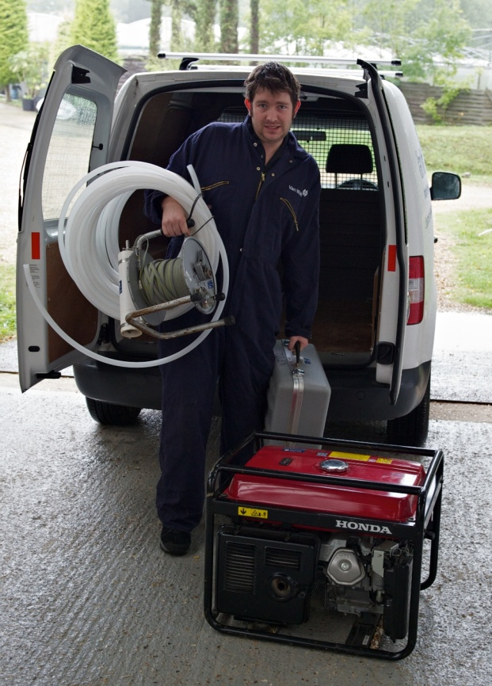

Conclusion

Slide 43
Any questions?

