Slide 1
Titel

Slide 2
Infiltration and hydraulic conductivity measurements

Slide 3
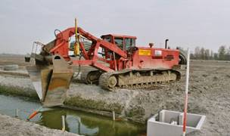
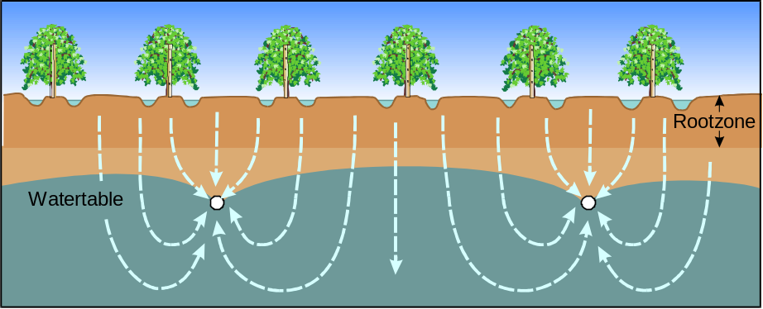
Why measurements?
Define drain distance

Slide 4
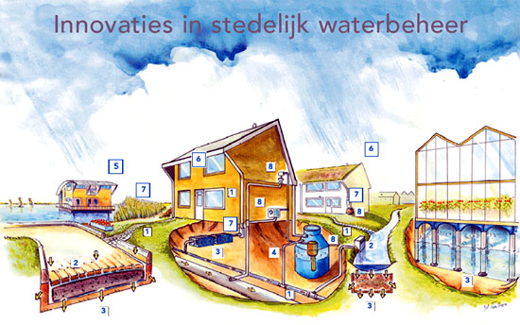
Why measurements?
Disconnect rainwater from sewersystem: infiltration in soil

Slide 5
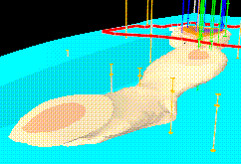
Why measurements?
Soil and groundwaterpollution: velocity of movement

Slide 6
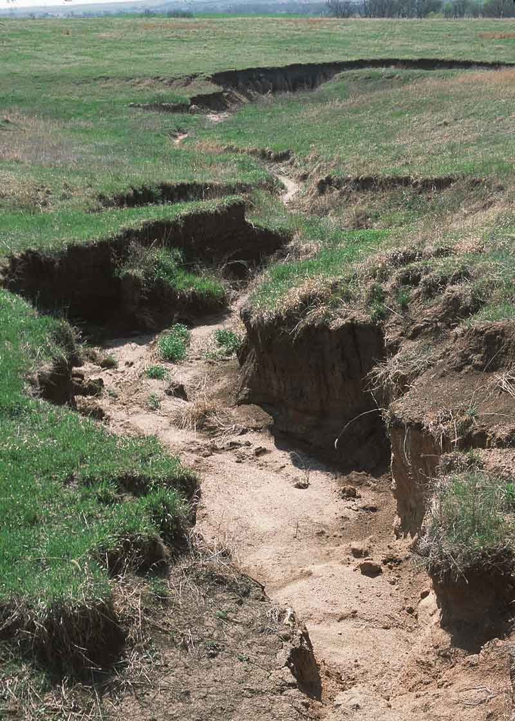
Why measurements?
Erosion sensibility

Slide 7
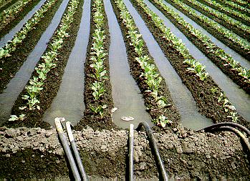
Why measurements?
Define infiltration velocity and depth

Slide 8
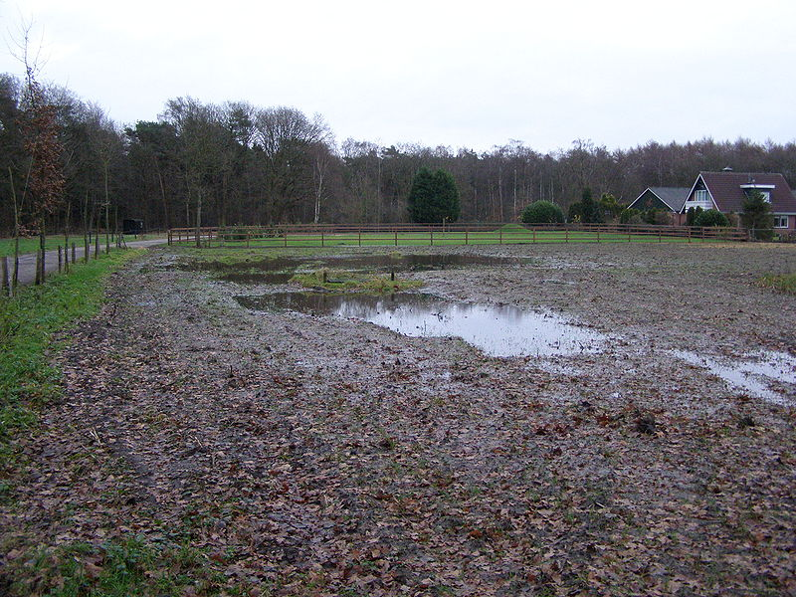
Why measurements?
Drainage problems: waterponding

Slide 9
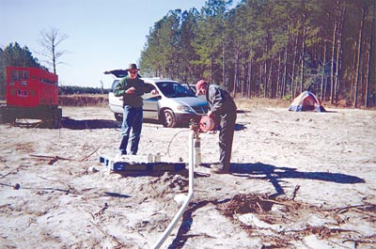
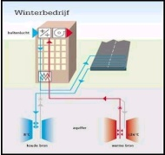
Why measurements?
Define disscharge and infiltrationcapacity of wells

Slide 10
Saturated and unsaturated zone
Groundwater zones
surface)
Hangwater zpendiculair zoneone
drilling hole
Unsaturated zone
Open capillaire zone
Soilwater zone
full capillaire zone
Saturated zone
groundwaterlevel
grounwaterzone
water

Slide 11
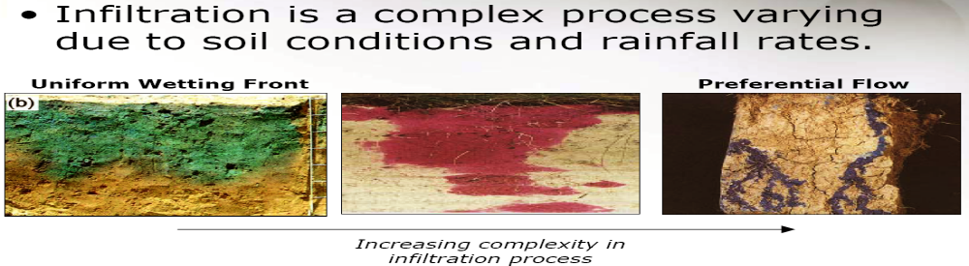
Infiltration
Infiltration is a complex process, differences by soilconditions and precipitation
Uniform moistening
Preferential flow
Increasing complexibility

Slide 12
Infiltration
What does the result mean ?
  K=< 5 cm/day bad permeability
  K= 5-40 cm/day average permeability
  K= 40-100 cm/day good permeability
  K=>100 cm/day very high permeability

Slide 13
Infiltration
Soil k in m/d
gravel >75
Coarse sand 30-75
Fine/coarse sand 10-30
Fine sand 1-10
Clayey sand 10⁻²-1
Sandy clay 10⁻³-10⁻¹
Clay 10⁻⁴-10⁻²
Peat 10⁻⁴ - 25

Slide 14
Infiltration
Before starting an infiltration measurement always make a soil profile.

Slide 15
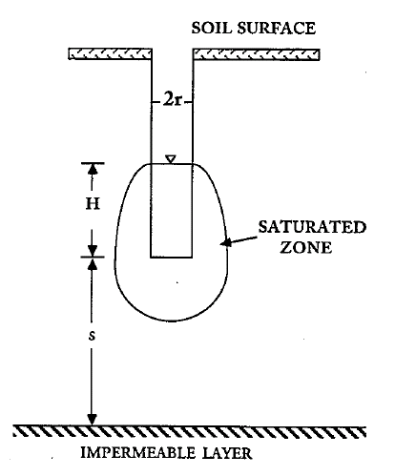
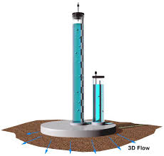
Infiltration
Saturated infiltration
Unsaturated infiltration

Slide 16
Infiltration
Surface infiltration
  Falling head (double ring)
  Unsaturated (tensio infiltro)
Sub surface
  Guelph (15 – 75 cm)
  Falling head (reversed Hooghoudt) (< 300 cm)
  Constant head (Ksat, Aardvark) (< 15 meters)
  Rising head (Hooghoudt) (< 200 cm

Slide 17
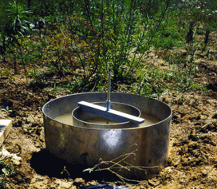
Ring-infiltrometer

Slide 18
Ring-infiltrometer
  Saturated infiltration measurements
    Water is put on or in the soil. The velocity with which the water flows into the soil is measured
  Benefits
    Ideal for infiltration measurement
    of top soils
    Perfect for flood / furrow
    irrigation advice
    Triple rings to get a representative
    average
    Stainless steel rings will last forever
    Determination of root zone permeability
    Determination of causes of waterlogged zones

Slide 19
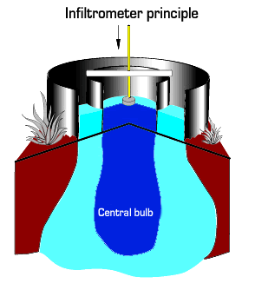
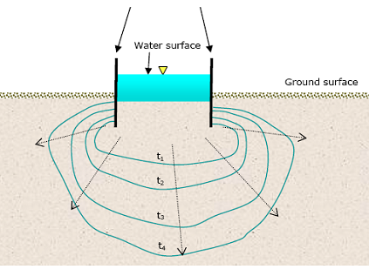
Ring-infiltrometer
Why 2 rings?
Single ring
Double ring

Slide 20
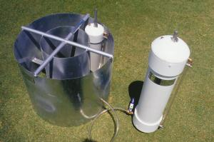
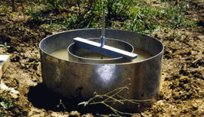
Ring-infiltrometer
2 types
Falling head
Constant head

Slide 21
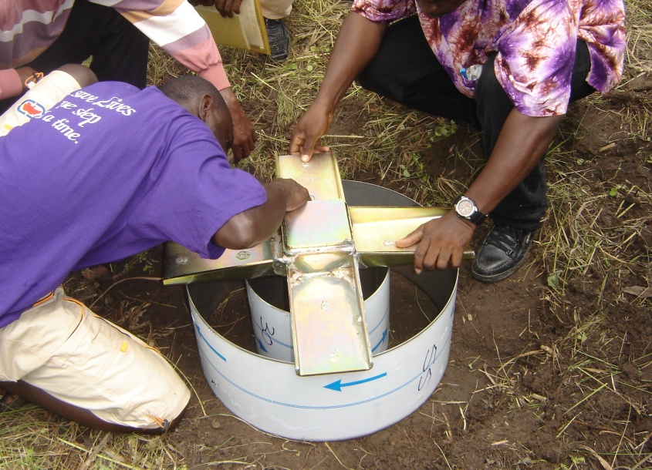
Ring-infiltrometer
  Remarks
    Additional profile research always needed
    Cracks / root channels disturb measurements
    Not for hard stony soils

Slide 22
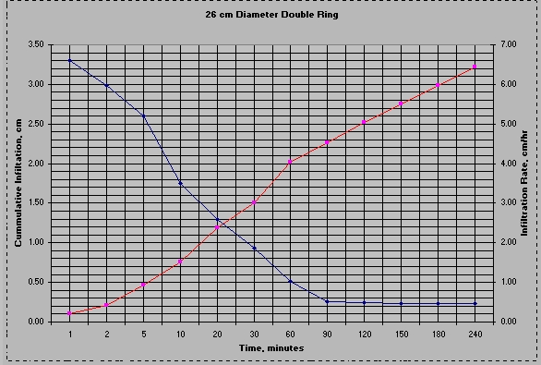
Cumulative Infiltration
(cm)
Infiltration Rate –cm/hr
Steady-State Rate (slope)
0.403 cm/hr
Fc = Ultimate Infiltration
Capacity (approx.0.47 cm/hr)

Slide 23
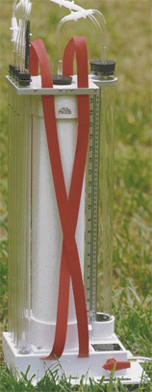
K-Sat “constant head permeameter”
K-Sat constant head permeameter
    Water is put in a hole in the soil.
    The volume of water flowing into the soil is measured. The hydrostatic pressure is kept stable (“constant head”).
  Benefits
    Determines permeability in any layer
    < 2 m (4 m)
    Meant for above the groundwater table
    Stable compact and versatile instrument
    Steady state principle for optimum accuracy
  Remarks: Requires skilled person

Slide 24

K-Sat
  Calculation of K based on Glover equation

Slide 25
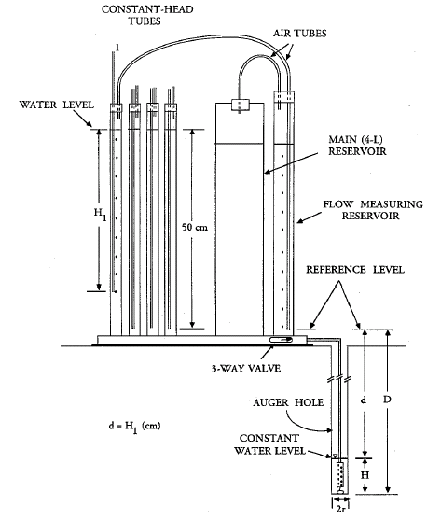
K-Sat
Use of Ksat

Slide 26
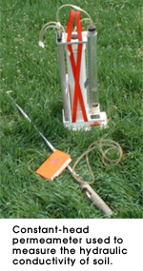
K-Sat
When
  For measuments up to 2 m below surface
  With extensionset up to 4 m

Slide 27
K-Sat
How
  Based on the creation of a constant water pressure in a borehole
  From borehole water spreads into the ground
  Calculation of K on the basis of the formula Glover

Slide 28
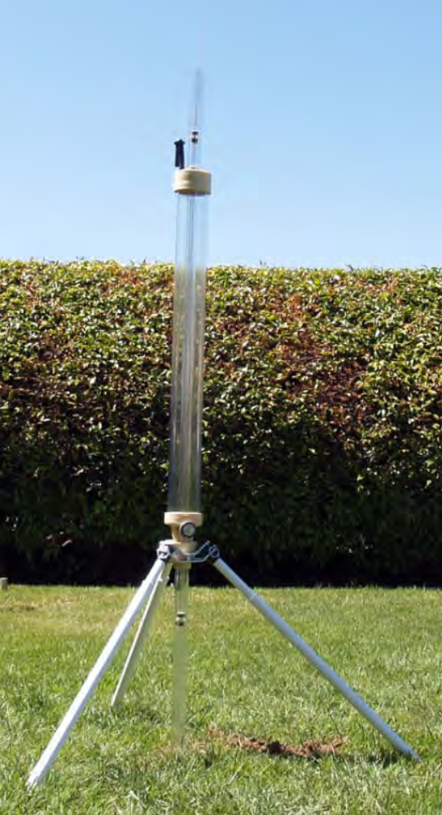
Guelph in situ permeameter

Slide 29
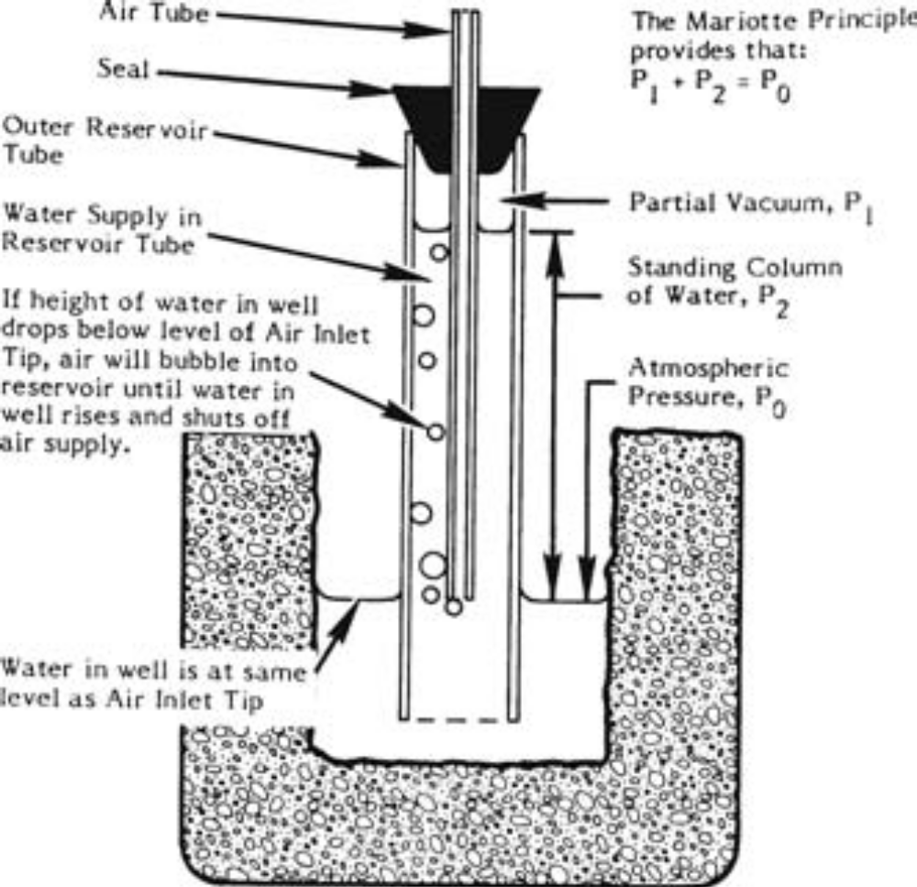
Guelph in situ permeameter

Slide 30
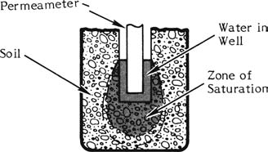
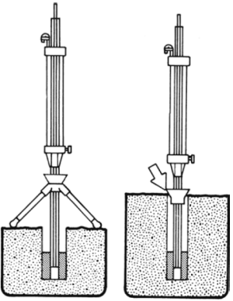
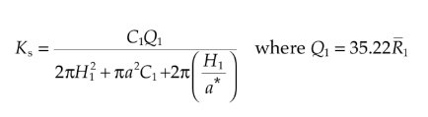
Guelph in situ permeameter
Priciple of Mariotte bottle
Saturated measurement
With or without tripod
Need skilled people
For calculation also a
spreadsheet available

Slide 31

Aardvark
Alternative for Ksat

Slide 32
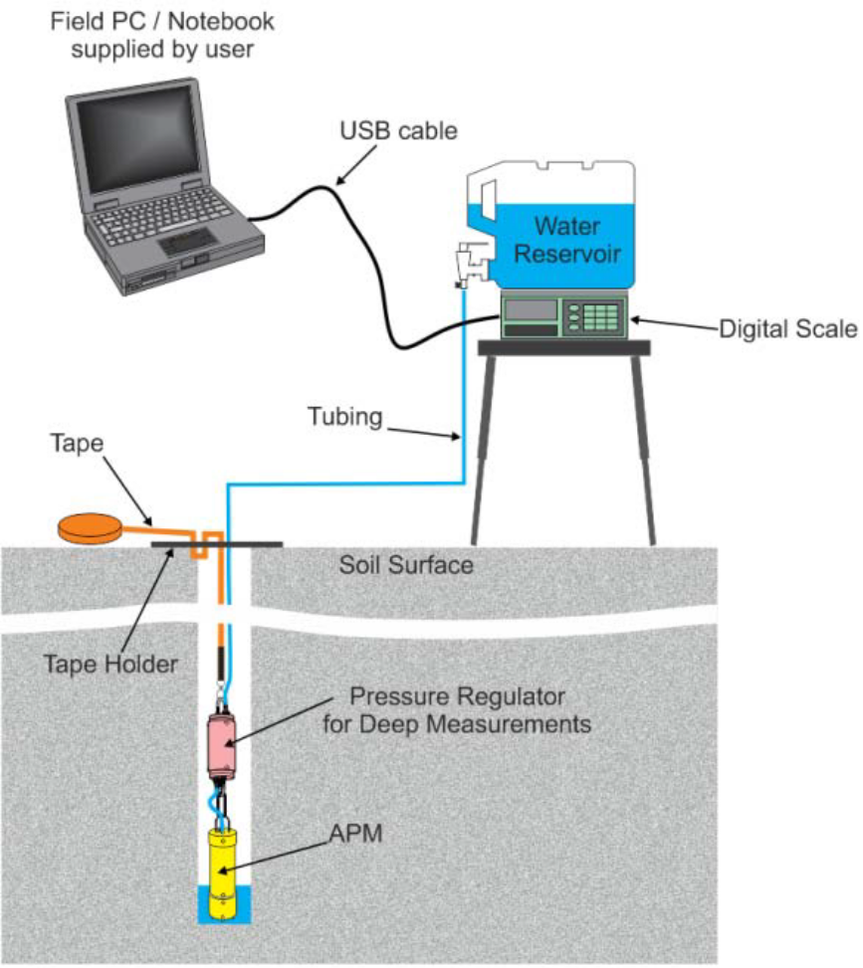
Aardvark
Constant head permeameter
Up to 15 meters depth
After calculation a complete report is generated

Slide 33
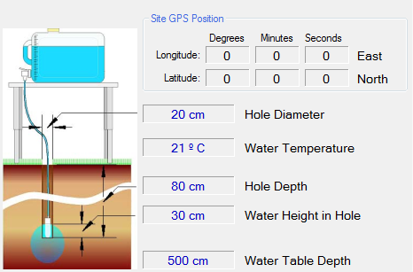
Aardvark

Slide 34
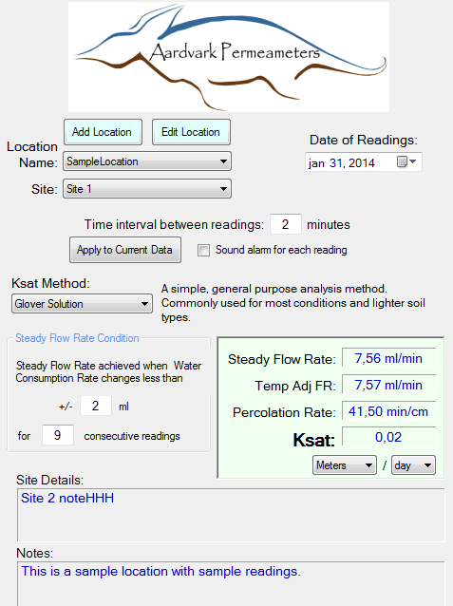
Aardvark

Slide 35
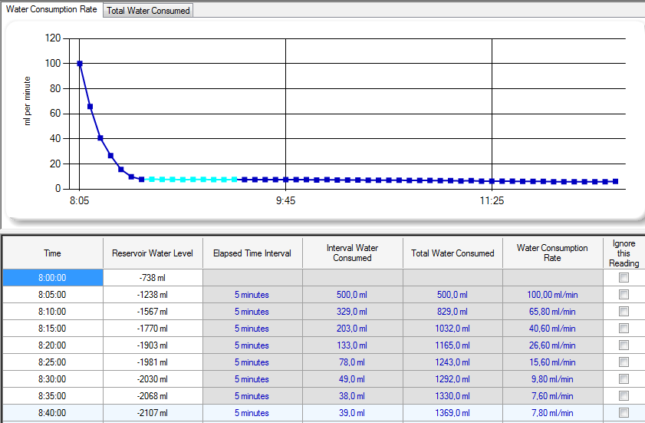
Aardvark

Slide 36
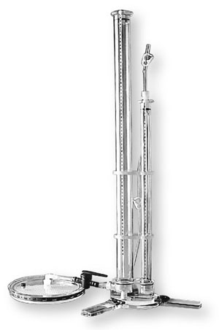
Tensio-infiltro meter
The tensio-infiltro meter measures the rate at which water infiltrates into the ground, but without saturating the soil with water

Slide 37
Tensio-infiltro meter
Working principle:
Suppose you bring a sponge in a bucket of water. Take the sponge out and let it drain. Then place it on the soil. If the soil is saturated, nothing will happen, the sponge remains wet. If the soil is dry, the ground immediately withdraw water from the sponge. The surface-infiltro meter works on the same basis. The soil should do something for it to draw the water out of the perforated disk
At the soil surface a thin layer of fine sand is brought on for optimum contact with the soil. The disc is connected to a water reservoir. A second water tank is used to control a minimum under pressure in order to prevent the water from flowing out freely. (a few cm water column)

Slide 38
Tensio-infiltro meter
Benefits:
Because the soil has to pull the water from the disk cracks and root / animals courses no affect
The soil is disturbed in no way (?)
Measurements can be carried out in a relative short period of time

Slide 39
Tensio-infiltro meter
Calculations
The measurements are carried out with at least 2 x a different under pressure (eg, 10 and 5 cm)
During the execution, the decline by time is measured in the measuring cylinder

Slide 40
Tensio-infiltro meter
Formulas
Q = πr2 K [1 + 4/πrα] (Wooding 1968)
Q = flow of water which infiltrates
K = hydraulic conductivity
r = radius circle shaped infiltration
α = ln [Q (h2) / Q (h1)
h2 - h1

Slide 41
Tensio-infiltro meter
The unsaturated hydraulic permeability varies with the pressure height (h)
Gardner (1958)
K (h) = exp Ksat (αh) for h ≤ 0
Combined gives:
Q (h1) = πr2 Ksat exp (αh1) [1 + 4/πrα]
Q (h2) = πr2 Ksat exp (αh2) [1 + 4/πrα]
This two parts give : α = ln [Q (h2) / Q (h1)
h2 - h1

Slide 42
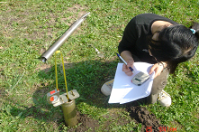
Hooghoudt method

Slide 43
Hooghoudt method
Hooghoudt method:
Intended to determine the water permeability of maximum TWO groundwater aquifers
Intended to a depth of 2 meters
Method takes into account the influence of any impermeable layer UNDER the aquifer

Slide 44
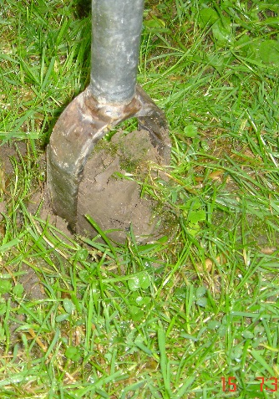
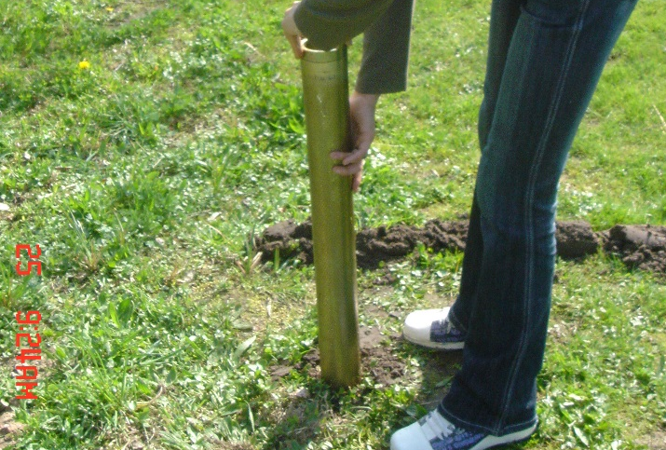
Hooghoudt borehole method
Borehole 8cm
At least 20 cm minus ACTUAL groundwater
Make borehole preferably one or several days
in advance.
If necessary (wet sand) stabilize borehole with
special filter tube

Slide 45
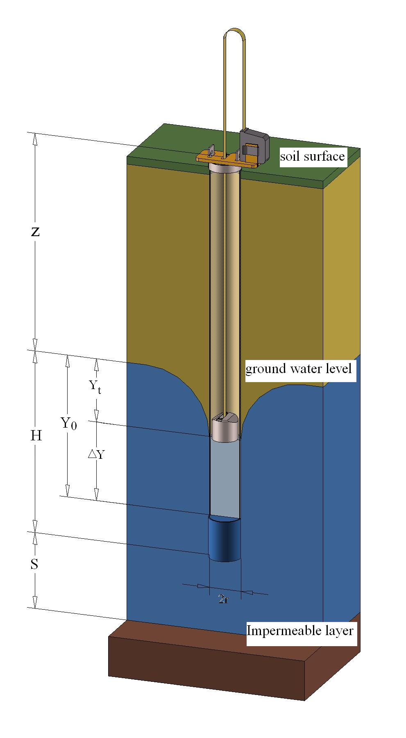
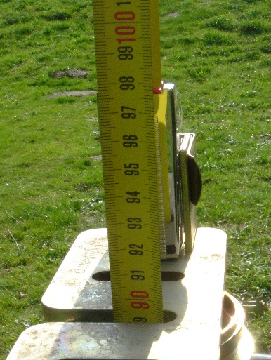
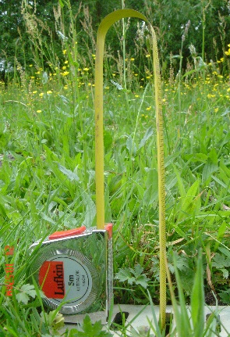
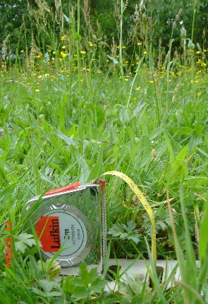
Hooghoudt borehole method
Determine than the value of z
Calculate S, S = distance in cm
between the bottom hole and
previously discovered
impermeable layer

Slide 46
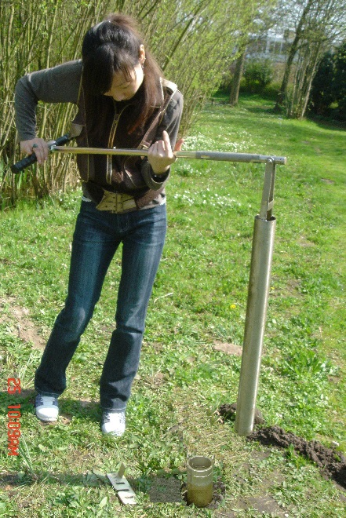
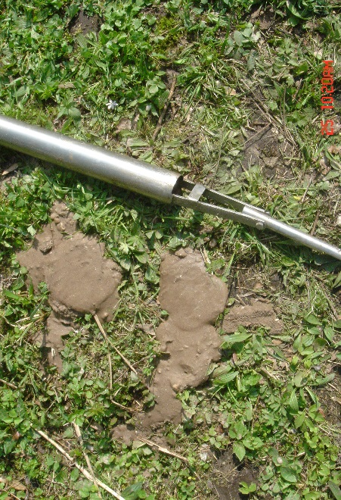
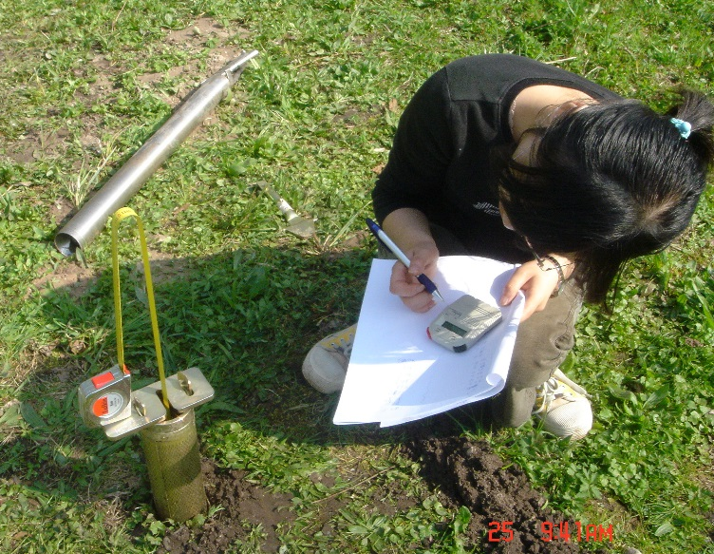
Hooghoudt borehole method
Remove 20-50 cm water from borehole ; usually with a pulse
Slide quickly floater down and place tape holder on surface or filter tube

Slide 47
Hooghoudt borehole method
Note the distance and time
Ascent rate decreases as original water level is approached
Therefore, use only the first 25 % of any increase range

Slide 48

Hooghoudt borehole method
Calculation two methods
1. Nomograms
2. Formulas

Slide 49
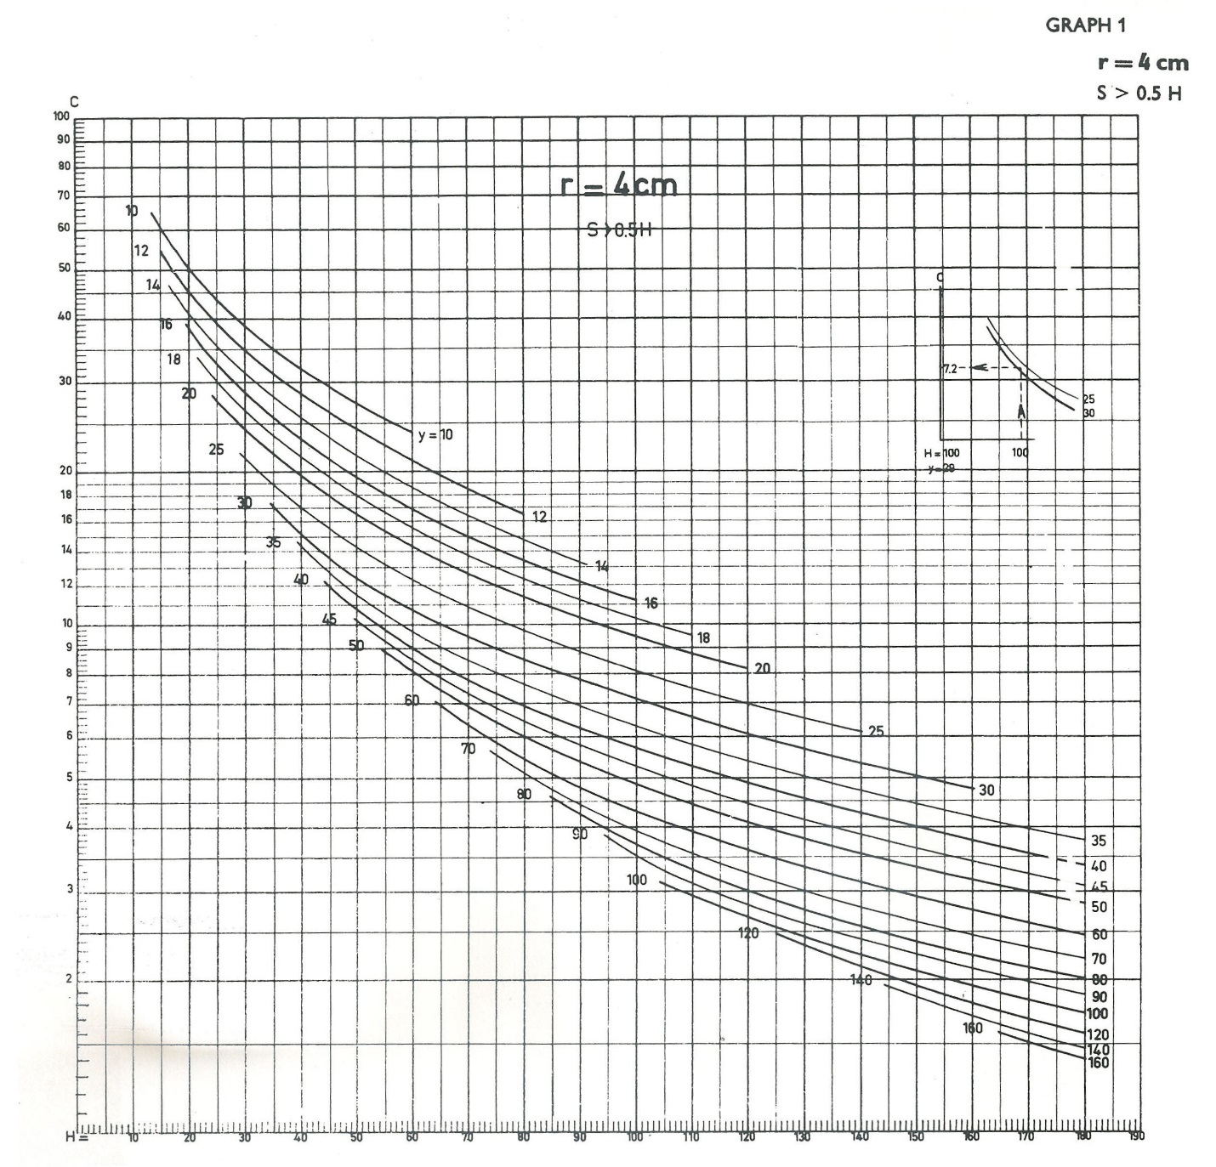

Hooghoudt

Slide 50
Reversed Hooghoudt borehole method
This method can be applied to successive depths in a borehole in order to measure the permeability of the different layers ( above ground water ) . When the ground water is deep (> 2 to 3 meters minus mv) the reverse Hooghoudt method can be applied
Method
Drill hole to specified depth
Fill with water
Measuring how fast watertable is dropping
The measurements for each borehole must be repeated until the difference between the measurements is less than 10 to 15% (repeat sandy profiles , repeated 3 to 6 times , clay / loam 2 to 3 times )

Slide 51
Reversed Hooghoudt borehole method
K = 1,15 * r_{w} * tanα
tanα = log(h(0) + r_{w}/2) – log(h(t) + r_{w}/2)
t

Slide 52
Reversed Hooghoudt borehole method
2r_{w}
surface
h(0)
h(t)
Monitoring well
borehole
groundwater

Slide 53
Any questions?

Slide 54
Pr gr no | Productgroup | Article no | Description
25 | Water permeability/infiltration E | 090104 | Measuring tape holder
25 | Water permeability/infiltration E | 090105 | Float
25 | Water permeability/infiltration E | 090115 | Interm.filter for bi-partite filter
25 | Water permeability/infiltration E | 09011501 | Top ring, pull-out
25 | Water permeability/infiltration E | 09011502 | Bottom cap for filter
25 | Water permeability/infiltration E | 090116B | Spatula for bi-partite filter, bay
25 | Water permeability/infiltration E | 0901SA | Hydraulic conductivity test kit
25 | Water permeability/infiltration E | 0901SB | Hydraulic conductivity test, Hooghoudt
25 | Water permeability/infiltration E | 0904 | Double ring infiltrometer,
25 | Water permeability/infiltration E | 09040101 | Infiltration ring, diam. 28 cm
25 | Water permeability/infiltration E | 09040102 | Infiltration ring, diam. 53 cm
25 | Water permeability/infiltration E | 09040201 | Infiltration ring, diam. 30 cm
25 | Water permeability/infiltration E | 09040202 | Infiltration ring, diam. 55 cm
25 | Water permeability/infiltration E | 09040301 | Infiltration ring, diam. 32 cm
25 | Water permeability/infiltration E | 09040302 | Infiltration ring, diam. 57 cm
25 | Water permeability/infiltration E | 090405 | Driving plate for 28 to 57 cm
25 | Water permeability/infiltration E | 090406 | Measuring bridge for ring infiltro meter
25 | Water permeability/infiltration E | 090407 | Float with measuring rod
25 | Water permeability/infiltration E | 0906 | Mini rainfall simulator for erosion test
25 | Water permeability/infiltration E | 090601 | Rainfall simulator for erosion tests
25 | Water permeability/infiltration E | 090611 | Soil wetting jar
25 | Water permeability/infiltration E | 090621 | Water storage tank, contents 20 liter
25 | Water permeability/infiltration E | 090631 | Sample collection box, 2 liter
25 | Water permeability/infiltration E | 090632 | Sample box with lid, contents 1.12 litre
25 | Water permeability/infiltration E | 090635 | Scraper
25 | Water permeability/infiltration E | 090641 | Aluminium transport case, 60x48x40 cm
25 | Water permeability/infiltration E | 090912 | Coupling part for transducer
26 | Water permeability/infiltration T | 090103 | Measuring tape, 5 m, steel enamelled
26 | Water permeability/infiltration T | 090109 | Stopwatch, digital, measuring range 10h
26 | Water permeability/infiltration T | 090110 | Carrying bag for field equipment
26 | Water permeability/infiltration T | 09011001 | Bag for float
26 | Water permeability/infiltration T | 090409 | Pull-out hook
26 | Water permeability/infiltration T | 0907 | Guelph constant head permeameter
26 | Water permeability/infiltration T | 090701 | Extension set for Guelph in-situ permeam
26 | Water permeability/infiltration T | 0909 | Tension infiltrometer, complete set
26 | Water permeability/infiltration T | 090901 | Tension infiltrometer, 20 cm
26 | Water permeability/infiltration T | 090903 | Hand vacuum pump for tension infiltrom.
26 | Water permeability/infiltration T | 090905 | Metal ring, diameter 20 cm
26 | Water permeability/infiltration T | 090907 | Nylon mesh screen for 20 cm, 5 pcs
26 | Water permeability/infiltration T | 090911 | Transducer for tension infiltrometer
26 | Water permeability/infiltration T | 090916 | CD-rom with software for Datahog 2
26 | Water permeability/infiltration T | 090920 | Read-out unit for Tension infiltrometer
26 | Water permeability/infiltration T | 0911 | Ksat constant head permeameter, set
26 | Water permeability/infiltration T | 091101 | Ksat permeameter
26 | Water permeability/infiltration T | 091201 | Aardvark Permeameter PC-Tablet
26 | Water permeability/infiltration T | 091204 | Aardvark Permeameter Flash
26 | Water permeability/infiltration T | 0912SA | Aardvark perm. PC-tablet, compl. set
26 | Water permeability/infiltration T | 0912SB | Aarvark permeameter flash, set

Slide 55
Some facts:
Sales increase in 2015 of 14%, expecting more growth in this product range
Best selling countries: Netherlands, Belgium, Germany, France
Main customers: Consulting, Research Institutes, Universities, Laboratories

